Slide 1
C3 – Chemical quantities
Key Concepts

Slide 2
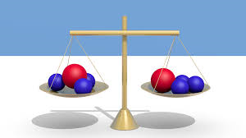
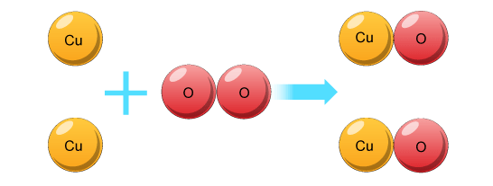
Law of conservation of mass
Law of conservation of mass states that the amounts of reactants must equal the amount of products.

Slide 3
Relative formula mass
Relative formula mass (Mr) is the sum of the relative atomic masses of the atoms.
Example
Magnesium oxide – MgO – has a R.F.M (M_{r}) of 40.
M_{r} MgO = 24 + 16 = 40
Na₂O
CuCO₃
Mg(OH)₂

Slide 4
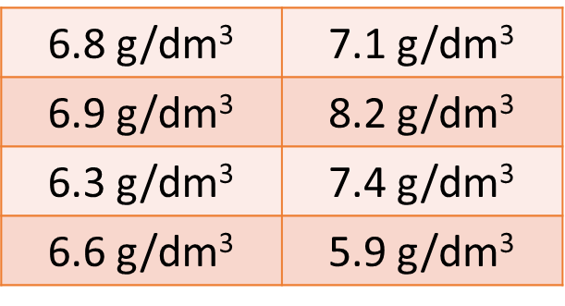
Calculating mean, range and uncertainty
Mean is calculated by adding all the sums and dividing by the how many are there.
Range = highest measurement – lowest measurements
There is always an uncertainty when a measurement is made.
Resolution – smallest amount of change to be measured
Range =
8.2 – 5.9 = 2.3 g/dm³
Mean =

Slide 5
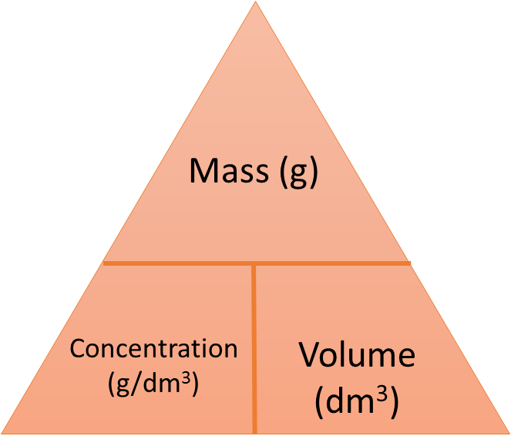
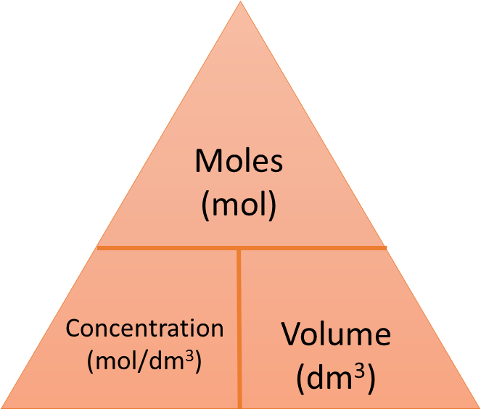
Concentration of solutions
Concentration triangles.
Higher

