Slide 1
C4 – Chemical changes
Key Concepts

Slide 2
Oxidation and Reduction
OIL RIG – oxidation is loss of electrons, reduction is gain of electrons.
During oxidation, sodium atoms lose electrons to make positive ions:
4Na - 4e⁻ → 4Na⁺
The oxygen atoms gain electrons to make negative ions:
O₂ + 4e⁻ → 2O²⁻
The oxygen is reduced.

Slide 3
Reactivity Series
Displacement Reactions – when a more reactive metal displaces a less reactive metal.
Example magnesium displaces iron as it is higher up in the reactivity series.

Slide 4
Making salts – Required Practical
Acid + base Salt + water
A soluble salt can be made by reacting an acid with an excess of an insoluble solid substance.
example
sodium hydroxide + hydrochloric acid sodium chloride + water
Hydrochloric acid – chloride salts
Sulfuric acid – sulphate salts
Nitric acid – nitrate salts

Slide 5
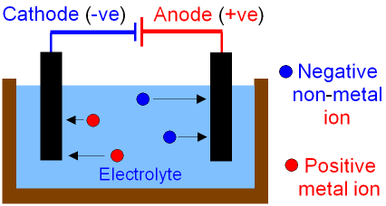
Electrolysis
Electrolysis is the process of passing electric current through a solution to move the ions to break the compound at the electrodes.

Slide 6
Electrolysis
Electrolyte – An ionic liquid that conducts electricity.
Cathode – the negative electrode.
Anode – the positive electrode.
Cation – a positively charged ion.
Anion – a negatively charged ion.

