Slide 1
C5 – Energy changes
Key Concepts

Slide 2
Exothermic reactions
Exothermic – reactions that give out energy to the surroundings (release energy).
Examples – combustion, neutralisation and oxidation reactions
The temperature of the reaction goes up.
Other examples self heating cans and hand warmers.

Slide 3
Endothermic reactions
Endothermic – reactions that take in energy from the surroundings (absorb energy)
Examples – thermal decomposition, photosynthesis
The temperature of the reaction does down.
Other examples sports injury packs.

Slide 4
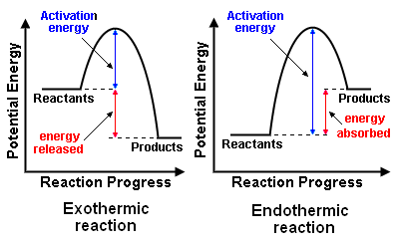
Reaction profiles

Slide 5
Breaking and Making Bonds – Higher Only
Bond breaking is an endothermic process
Bond making is an exothermic process
The energy needed to break bonds and the energy released when bonds are formed can be calculated from bond energies.
Energy change of the reaction is the sum of the energy needed to break the bonds in the reactants and sum of the energy released when bonds in the products are formed.

