Slide 1
Biology Paper 1

Slide 2
Cell Biology
What types of cell are eukaryotic?
Animal, plant, fungi (yeast) and Protist (plamosdium)
What are the key features of eukaryotic cells?
Cell has a nucleus with genetic material inside + membrane –bound organelles
What types of cell are prokaryotic?
Bacteria
What are the key features of prokaryotic cells?
No nucleus – genetic material loose in cytoplasm and plasmids, much smaller in size

Slide 3
Cell Biology
What units would you use to measure a cell?
Micrometres (µm)
How many micrometres are there in a millimetre?
1000 µm
How would you represent 1 millimetre in standard form?
10⁻³
How would you represent 1 micrometre in standard form?
10⁻⁶
How would you represent 1 nanometre in standard form?
10⁻⁹

Slide 4
Cell Biology
Cytoplasm
Nucleus
Cell Membrane
Cell Wall
Mitochondria
Vacuole
Chloroplast

Slide 5
Cell Biology
What do the following parts of cells do?
Nucleus?
Controls cell/contains DNA
Cytoplasm?
Where chemical reactions take place
Cell membrane?
Controls what enters and exits cells
Mitochondria?
Where respiration takes place
Ribosomes?
Where proteins are made

Slide 6
Cell Biology
What do the following parts of cells do?
Cell Wall?
Provides support
Vacuole?
Contains cell sap
Chloroplast?
Where photosynthesis takes place
Name three parts of plant cells that are not found in animal cells
Chloroplasts, cell wall, vacuole

Slide 7
Cell Biology
What are specialised cells?
Cells that have differentiated for a particular role
Can you name any specialised animal cells?
Sperm cell, nerve cell, red blood cell, white blood cell, muscle cell, epithelial cell
Can you name any specialised plant cells?
Root hair cells, xylem, phloem, palisade mesophyll

Slide 8
Cell Biology
What is meant by cell differentiation?
When a cell becomes specialised for a particular function e.g. a muscle cell
When do animal cells differentiate?
Most differentiate at an early stage of development (embryo)
When do plant cells differentiate?
Can differentiate throughout their lives (this explains why plants can form new organs like leaves and roots).
What is cell division restricted for in mature animals?
Repair and replacement

Slide 9
Cell Biology
What are the two main types of microscope?
Light and electron
Which type has the highest magnification and resolution?
Electron microscope
What are you able to see in cells with an electron microscope that you can’t with a light microscope?
Sub-cellular structures like mitochondria and chloroplasts
What are some of the disadvantages of electron microscopes?
Cannot use living cells – vacuum, specimen preparation is complex, expensive

Slide 10
Cell Biology
What is the equation for magnification?
magnification = image size (mm) ÷ actual size (µm)
What is the triangle to rearrange the equation above?
Image Size (mm) use a ruler to measure the cell/scale bar
I
Actual size (µm)
Magnification
A
x
M

Slide 11
Cell Biology
What is inside the nucleus?
Chromosomes
What are chromosomes made of?
DNA
What are genes?
Sections of DNA that code for a particular protein/feature
How many chromosomes do human body cells have?
46, in 23 pairs
How many chromosomes would you find in an egg or a sperm cell?
23
How many chromosomes would you find in a fertilised egg cell?
46

Slide 12
Cell Biology
What is the cell cycle?
A series of stages where the cell prepares for, and carries out cell division
What must happen to the DNA before cell division?
Replicates (doubles)
What must the cell do before division?
Grow and produce more sub-cellular structures such as mitochondria
What is mitosis?
Division of the nucleus

Slide 13
Cell Biology
What happens in mitosis?
Chromosomes are split and pulled to opposite ends of the cell
What is the final part of the cell cycle?
Cytoplasm and cell membrane divide to form two identical cells
Why is cell division important?
Makes new cells for growth and repair

Slide 14
Cell Biology
What are stem cells?
Undifferentiated cells that can form any type of cell
Where can you get human stem cells from?
Adult bone marrow, embryos
What types of cells can adult bone marrow stem cells form?
Blood cells
What types of cells can embryonic stem cells form?
Any type of cell
What could embryonic stem cells be used to treat in the future?
Diabetes, paralysis, alzheimer's

Slide 15
Cell Biology
What is therapeutic cloning?
Where you produce an embryo using your own genes, which will provide you with your own stem cells
What are the advantages of therapeutic cloning over using embryonic stem cells?
No rejection (they are your own cells), less ethical concerns
What are the risks of stem cells?
Viral transfers, ethical and religious objections

Slide 16
Cell Biology
Where can plant cell stem cells be found?
Meristems
Stem cells from plant meristem cane be used for?
Making clones quickly
What are the advantages of cloning plants?
Can produce large numbers of plants, can ensure particular features such as disease resistance will be passed on

Slide 17
Cell Biology
What is diffusion?
The movement of particles from an area of high concentration to an area of low concentration.
What substances may diffuse into an animal cell?
Oxygen, glucose, amino acids
What substance may diffuse out of a cell?
Carbon dioxide, urea
What factors affect the rate of diffusion?
Steepness of concentration gradient, temperature, surface area of the cell membrane

Slide 18
Cell Biology
Why don’t single cell organisms need a exchange surfaces or transport systems?
They have a large surface area: volume ratio compared to multicellular organisms.
Can you name any exchange surfaces?
Lungs, gills, small intestines roots, leaves
What are the key adaptations of exchange surfaces?
Large surface area
thin – short diffusion distance
close to a transport system – maintains a steep concentration gradient

Slide 19
Cell Biology
What is osmosis?
The movement of water molecules from a dilute to a more concentrated solution across a partially permeable membrane.
What would happen to a piece of potato if it is placed in a solution that is more dilute solution than its cells?
Water would move in via osmosis and its cells would swell and it would gain mass
What would happen to a piece of potato if it is placed in a solution that is more concentrated solution than its cells?
Water would move out via osmosis and its cells would shrivel and it would lose mass

Slide 20
Cell Biology
What is active transport
The movement of substance from an area of low concentration to an area of high concentration (against a concentration gradient) using energy from respiration.
What else is required for active transport?
Carrier proteins in the membrane
Where is active transport important in animals?
Small intestine to absorb glucose etc. into the blood
Where is active transport important in plants?
In the roots to absorb mineral ions from the soil

Slide 21
Organisation
How are multicellular organisms organised?
Cells, tissues, organs, organ system, organism
What is a tissue?
A group of cells that are working together for the same function
What are organs?
A group of different tissues working together for the same function
What are organ systems?
Groups of organs working together for the same function

Slide 22
Organisation
What are the organs involved in the digestive system?
Mouth, Oesophagus, stomach, small intestine, large intestine, liver, gall bladder, pancreas
What is digestion?
The breakdown of large, insoluble molecules into small more soluble ones that can be absorbed into the blood
What is metabolism?
The rate of chemical reactions in your cells
What controls your metabolism?
Enzymes

Slide 23
Organisation
What are enzymes?
Biological catalysts
What are catalysts?
They speed chemical reactions without being used up.
What is most important part of an enzyme?
Active site
What fits into the active site?
Substrate
Can anything fit into the active site?
No- each enzyme has a specific substrate they fit together like a lock and key

Slide 24
Organisation
What factors affect enzymes?
Temperature and pH
How does temperature affect enzymes?
-increasing the temperature at first increases reaction rate as there are more collisions between enzyme and substrate.
-increasing the temperature too high causes the enzyme to denature.
How does pH affect enzymes?
Each enzyme as an optimum pH where it works best, extremes in pH cause them to denature

Slide 25
Organisation
What are the three main types of digestive enzyme?
Carbohydrase's (amylase)
Protease
Lipase
Where is amylase produced?
Salivary glans, pancreas and small intestine
Where are proteases produced?
Stomach, pancreas and small intestine
What are lipases produced?
Pancreas and small intestine

Slide 26
Organisation
What do Carbohydrase's (amylase) break down?
Starch → glucose
What do Proteases break down?
Protein → amino acids
What do Lipases break down?
Lipids → fatty acids + glycerol

Slide 27
Organisation
What is also required to help digest lipids (fats)?
Bile
Where is bile made?
Liver, and it is stored in the gall bladder
How does bile aid in lipid digestion?
-Neutralises stomach acid – making optimum pH for lipase
-Emulsifies fats – increases surface area for lipase

Slide 28
Organisation
What test is used for glucose?
Benedict's test
What does a positive Benedict's test look like?
Blue to red
What is the test for starch?
Iodine
What does a positive starch test look like
Orange to black
What is the test for proteins?
-Biuret
What test does a positive protein test look like?
Blue to purple

Slide 29
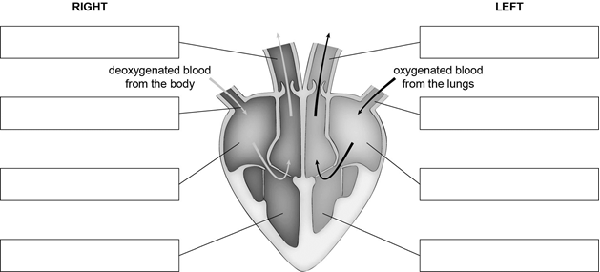
Organisation
Can you label the parts of the heart?
Pulmonary artery
Aorta
Vena Cava
Pulmonary vein
Right atrium
Left atrium
Right ventricle
Left ventricle

Slide 30
Organisation
What are the three types of blood vessels called?
Arteries, veins and capillaries
What are the key features of arteries ?
-thick, muscular elastic walls
-narrow lumen
Why do arteries have these features?
Maintain high blood pressure
What are the main features of veins?
-thin walls
Large lumen
valves

Slide 31
Organisation
What are the functions of valves?
Prevent backflow of blood
What are the key features of capillaries?
-Thin- 1 cell thick
-large surface area
Why are capillaries are so thin?
Short diffusion distance for substances such as oxygen and carbon dioxide
What controls the resting heart rate?
specialised cells in the right atrium that act as a pacemaker

Slide 32
Organisation
What are the parts of the blood called?
Red blood cells, white blood cells, plasma, platelets
What is the role of red blood cells?
Transport oxygen
What is the role of white blood cells?
Destroy pathogens
What is the role of plasma?
Transport a range of substances such as carbon dioxide, urea, glucose, hormones and antibodies
What is the role of platelets?
To form blood clots when activated

Slide 33
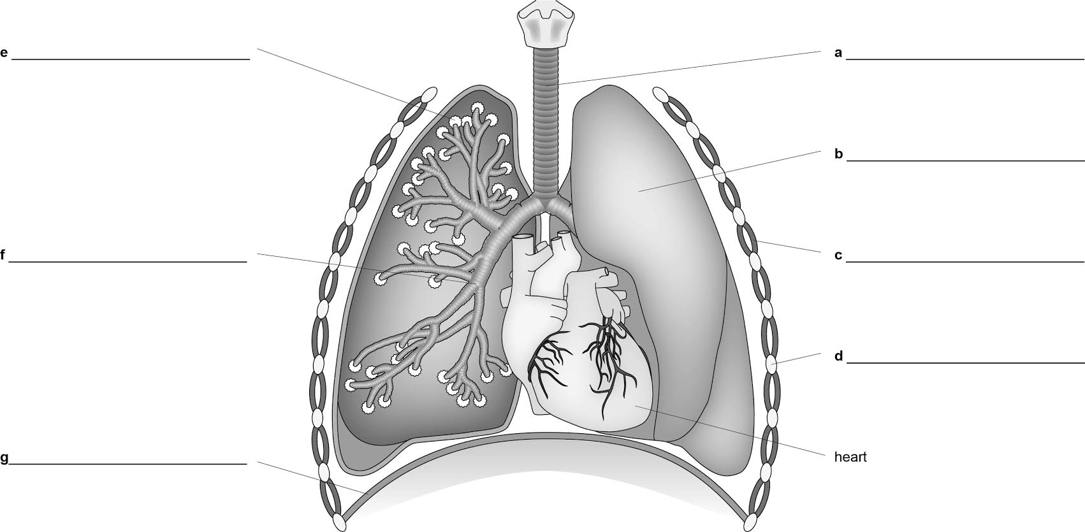
Organisation
What are the parts of the respiratory system called?
Alveoli
Trachea
Lung
Bronchus
Intercostal muscle
Rib bone
Diaphragm

Slide 34
Organisation
What blood vessel supplies the hear muscle with oxygenated blood?
Coronary artery
What is coronary heart disease?
Fatty material blocks the coronary artery which reduces blood flow. This reduces the amount of oxygen reaching the heart tissue causing it to die.
What three treatments are used for coronary heart disease?
-stents
-bypass surgery
-Statins – lower cholesterol levels in the blood

Slide 35
Organisation
Heart valves can become damaged, how can they be treated?
Replace with: mechanical or biological valves
If someone has an irregular heart rate, what is the main treatment?
Artificial pacemaker
If a persons hear fails what is treatments are available?
Heart transplant, or artificial heart (short-term)
What is the major limitation of heart transplants?
Shortage of donor hearts

Slide 36
Organisation
What is health?
A state of physical and mental well-being
What are communicable diseases?
Diseases that are caused by infectious pathogens
What are non-communicable diseases?
Diseases caused by lifestyle, environmental or genetic factors
Can you name any lifestyle factors that can lead to non-communicable diseases?
Diet, alcohol, smoking – also consider the financial cost of the diseases these can lead to

Slide 37
Organisation
What is a causal mechanism in terms of non-communicable disease?
A proven risk factor that causes disease
What risk factors are likely to cause cardiovascular disease?
Diet, smoking and lack of exercise
What diseases will smoking cause?
Lung disease and lung cancer
What are carcinogens?
Chemicals that cause cancer

Slide 38
Organisation
What is cancer?
Cells that undergo uncontrolled cell division
What are benign tumours?
Cancer that stays in one area and does not spread
What are malignant tumours?
Cancers that do spread to other parts of the body in the blood and form secondary tumours

Slide 39
Organisation
What are the main tissues in the leaf?
Epidermal, palisade mesophyll, spongy mesophyll
Is the leaf an organ?
Yes – it is made of many different tissues working together
What is transpiration?
The movement of water up through the plant caused by evaporation form the leaves
What factors affect transpiration?
-Increasing the temperature
-Windy
-Decreasing the humidity

Slide 40
Organisation
What plant tissue transports water and mineral ions in the plant?
Xylem
What are the key features of the xylem?
-dead hollow cells
What are the holes on the underside of leaves called?
Stomata
What controls the size of the stomata?
Guard cells

Slide 41
Organisation
What do phloem transport?
Sugars and water
What is translocation?
The movement of sugars from the leaves to other areas of plant in the phloem
Why is translocation important to the plant?
-Provides sugars to the roots which are unable to make their own.
-They can use the sugars transported to them for respiration.

Slide 42
Infection and Response
What are pathogens?
Microorganisms that cause communicable diseases
What are the main types of pathogen (4)?
-bacteria
-viruses
-fungi
-protists

Slide 43
Infection and Response
What are pathogens?
Microorganisms that cause communicable diseases
What are the main types of pathogen (4)?
-bacteria
-viruses
-fungi
-protists

Slide 44
Infection and Response
How do bacteria make you ill?
-Reproduce rapidly inside the body
-Produce toxins
How do viruses make you ill?
-Live and reproduce inside cells
-Cause cell damage
Can you name three viruses?
-Measles, HIV, tobacco mosaic virus (TMV)

Slide 45
Infection and Response
How is measles spread?
Droplets from sneezing and coughing
How is the spread of measles controlled?
Vaccination in children (MMR)
How is HIV spread?
Exchange of body fluids – sexual intercourse and sharing needles
What does HIV do?
Attacks the white blood cells, leading to AIDS – immune system failure

Slide 46
Infection and Response
How is HIV treated?
Antiretroviral drugs – reduces spread of viruses in the body (does not cure the disease)
What the symptoms of TMV?
Brown spots on the leaves (mosaic pattern)
Why is TMV a problem to farmers?
Damages the leaves- reduces photosynthesis so less crop produced

Slide 47
Infection and Response
What does salmonella bacteria cause?
Food poisoning
How is salmonella transmitted?
Unhygienic conditions in food preparation
How is salmonella controlled?
Increased food hygiene, poultry are vaccinated against it
What are the symptoms of gonorrhoea infection?
-Thick yellow/green discharge from vagina and penis
-Pain when urinating

Slide 48
Infection and Response
How is gonorrhoea controlled?
Condoms, antibiotics
What is the name of the fungal disease you need to know for the exam?
Rose black spot
How is it spread?
-spores travel in water or the wind
How is rose black spot controlled?
-Fungicides
-Destroy infected leaves

Slide 49
Infection and Response
What causes malaria?
Protist - Plasmodium
What transmits the disease?
Vector -mosquito
What are the key life cycle stages of malaria?
-Injected in blood in mosquito salvia
-Travels to liver and reproduces
-Leaves the liver and enters the blood and damages red blood cells
How is malaria controlled?
-Mosquito nets
-Insecticides where mosquitos breed (water)

Slide 50
Infection and Response
What physical defences does the human body have against pathogens?
-Skin
-Nose
-Trachea and bronchi (cilia and goblet cells)
-Stomach (hydrochloric acid - pH2)
What is the main defence system of the body?
White blood cells
How do white blood cells defend against pathogens (3)?
-Phagocytosis
-Antibody production
-Antitoxin production

Slide 51
Infection and Response
What does a vaccine contain?
-Dead pathogens
How do vaccines work?
-Stimulate white blood cells to produce antibodies
-If the same pathogen enters the body the white blood cells rapidly produce antibodies
-Antibodies kill pathogen before you get ill - immunity
Why is immunisation more effective on a large scale
If more people are vaccinated then it is more difficult for the disease to spread through the population

Slide 52
Infection and Response
What are antibiotics used for?
Treat bacterial infections
What has happened due the misuse of antibiotics?
Antibiotic resistant bacteria
Can antibiotics be used to kill viruses?
No – only effective at killing bacteria
What is the key difference between drugs like painkillers and antibiotics?
-Antibiotics treat the cause of disease
-Drugs like painkillers only treat the symptoms

Slide 53
Infection and Response
What two factors such new drugs be?
-Effective
-Safe
What are new drugs tested for (3)?
-Toxicity
-Efficacy
-Dose
What are new drugs tested on first?
Cells and animals

Slide 54
Infection and Response
What are the main stages of clinical trials?
-Use a small number of healthy volunteers – test safety
-Use a small number of patients – work out dosage
-Use a large number of patients to test long-term side effects
What is a double-blind trial
-Both patients and doctors in drug trial do not know if they are given a placebo or the new drug.
What is a placebo?
Resembles the drug (pill/injection) but does not contain the drug – e.g. sugar pill.

Slide 55
Bioenergetics
What is the word equation for photosynthesis?
Carbon Dioxide + Water → Glucose + Oxygen
What is the balanced symbol equation (HIGHER)?
6CO₂ + 6H₂O → C₆H₁₂O₆ + 6O₂
Is photosynthesis endothermic or exothermic?
Endothermic – light energy is absorbed by the chlorophyll to enable to reaction
What are the 3 limiting factors for photosynthesis?
-Temperature – enzyme controlled reaction
-Light intensity – provides energy
-Carbon dioxide concentration – key reactant

Slide 56
Bioenergetics
What are the uses of glucose by plants (5)?
-Respiration
Starch – energy storage
Fats – energy storage
Cellulose – cell walls
Amino acids – to make proteins
To make amino acids what else does the plant require?
-Mineral ion nitrate from the soil

Slide 57
Bioenergetics
What is respiration in cells for?
Release energy
Is respiration endothermic or exothermic?
Exothermic – it releases energy
Why do organisms need energy (3)?
-Build up molecules – e.g. amino acids to proteins
-Movement
-Keeping warm

Slide 58
Bioenergetics
What is the word equation for aerobic respiration?
Glucose + Oxygen → Carbon Dioxide + Water + (energy)
What is the balanced symbol equation for aerobic respiration?
C₆H₁₂O₆ + 6O₂ → 6CO₂ + 6H₂O
What are the two types of respiration called?
-aerobic
-anaerobic

Slide 59
Bioenergetics
What is the word equation for anaerobic respiration in animals?
Glucose → Lactic acid+ (energy)
What is the is the word equation for anaerobic respiration in yeast?
Glucose → Carbon Dioxide + Ethanol + (energy)
What is anaerobic respiration in yeast used to make (2)?
-alcohol
-bread

Slide 60
Bioenergetics
What happens to energy demand in body during exercise?
It increases
How does your body respond to this energy demand (2)?
-Increased breathing rate
-Increased heart rate
Why does breathing rate increase?
-To absorb more oxygen and remove more carbon dioxide
Why does heart rate increase?
- To pump more oxygenated blood to muscles

Slide 61
Bioenergetics
What happens if not enough oxygen reaches the muscles?
Anaerobic respiration starts
What is the problem with anaerobic respiration?
Causes muscle fatigue and cramp – they can no longer contract
How is lactic acid broken down (HIGHER)?
It is transported to the liver and oxygen is used to convert it back into glucose
What is the extra amount of oxygen required by your body after exercise called?
Oxygen debt

