Slide 1
C7: Hydrocarbons
Key Concepts

Slide 2
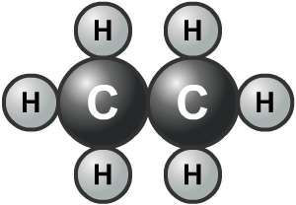
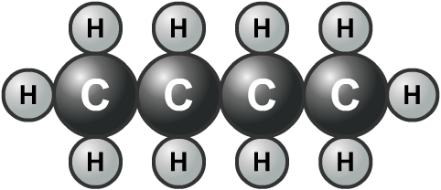
Hydrocarbons in crude oil
Many compounds in crude oil only contain the elements carbon and hydrogen. They are called hydrocarbons.
Most hydrocarbons in crude oil are compounds called alkanes. Alkanes contain a single chain of carbon atoms with hydrogen atoms bonded along the side.

Slide 3
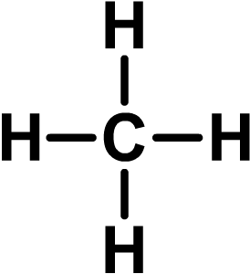
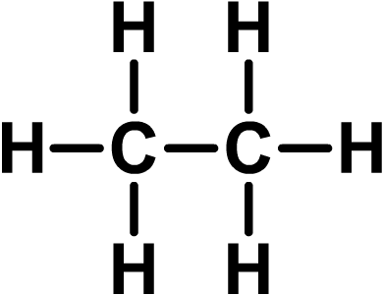
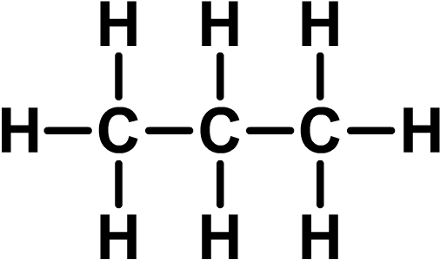
What are alkanes?
Alkanes are a family of hydrocarbon compounds with the general formula C_{n}H_{2n+2}.
The simplest alkane is methane. It has the formula CH₄.
The second simplest alkane is ethane. It has the formula C₂H₆.
The third simplest alkane is propane. It has the formula C₃H₈.
Notes:
Teacher notes
The alkanes are a homologues series and it should be pointed out to students that the general formula allows the molecular formula of any alkane to be determined. The naming of alkanes could also be introduced, making it clear that all alkanes end in ‘-ane’. The start of the name denotes the number of carbon atoms in each molecule.

Slide 4
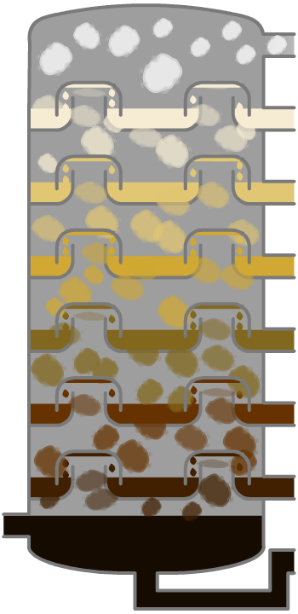
Fractional distillation of crude oil
1. Oil is heated to about 450 °C and pumped into the bottom of a tall tower called a fractionating column, where it vaporizes.
2. The column is very hot at the bottom but much cooler at the top. As the vaporized oil rises, it cools and condenses.
3. Heavy fractions (containing large molecules) have a high boiling point and condense near the bottom of the column.
4. Lighter fractions (containing small molecules) have a lower boiling point and condense further up the column.

Slide 5
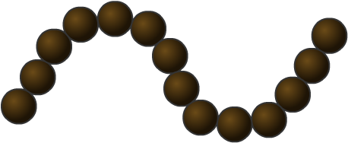
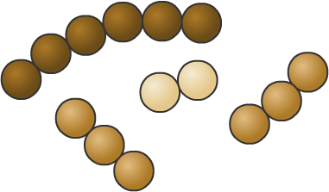
Catalytic cracking
Large hydrocarbon molecules can be broken down into smaller molecules using a catalyst. This is called catalytic cracking, and is an example of a thermal decomposition reaction.
The hydrocarbon molecules are heated until they turn into vapour, and then mixed with a catalyst. The molecules break apart, forming smaller alkanes and alkenes.
Alkenes are reactive molecules that are used to make plastics and other chemicals.
Notes:
Teacher notes
It may be worth pointing out to students that the molecules crack – rather than burn – when heated, because oxygen is kept out of the reaction vessel.

Slide 6
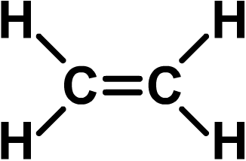
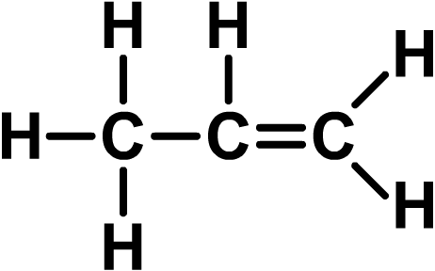
What are alkenes?
Alkenes are very similar to alkanes, but they have one important difference: they contain at least one double covalent bond between carbon atoms.
Alkenes are a family of hydrocarbon compounds with the general formula C_{n}H_{2n}.
The simplest alkene is ethene. It has the formula C₂H₄.
The second simplest alkene is propene. It has the formula C₃H₆.
Notes:
Teacher notes
The alkenes are a homologues series and it should be pointed out to students that the general formula allows the molecular formula of any alkene to be determined. The naming of alkenes could also be introduced, making it clear that all alkenes end in ‘-ene’. The start of the name denotes the number of carbon atoms in each molecule.

Slide 7
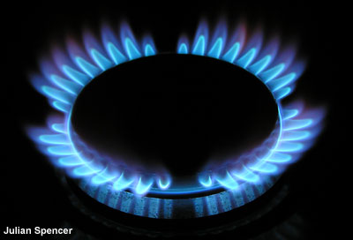
Complete combustion of hydrocarbons
Plenty of air is needed to provide enough oxygen for a hydrocarbon fuel to burn completely.
The blue flame of a gas hob or a Bunsen burner is an example of complete combustion of a hydrocarbon (in this case, natural gas).
What are the products of the complete combustion of a hydrocarbon?
+
carbon dioxide
+
hydrocarbon
oxygen
➔
water
Notes:
Photo credit: Julian Spencer

Slide 8
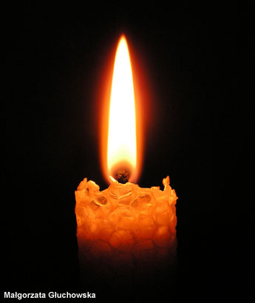
Incomplete combustion of hydrocarbons
If there is a shortage of air (oxygen), incomplete combustion of hydrocarbons takes place.
Instead of producing just carbon dioxide and water, incomplete combustion also produces carbon monoxide and/or carbon (soot). It also releases less energy than complete combustion.
Carbon monoxide is a poisonous gas because it reduces the ability of blood to carry oxygen.
Notes:
Photo credit: Małgorzata Głuchowska (www.lilja-art.net)

