Slide 1
C8: Chemical Analysis
Key Concepts

Slide 2
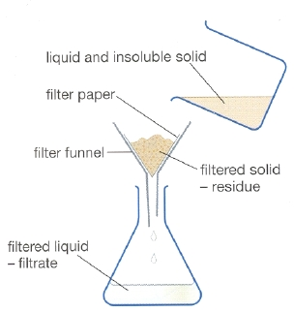
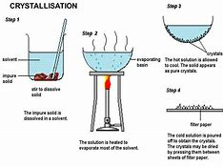
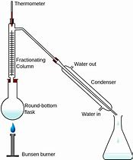
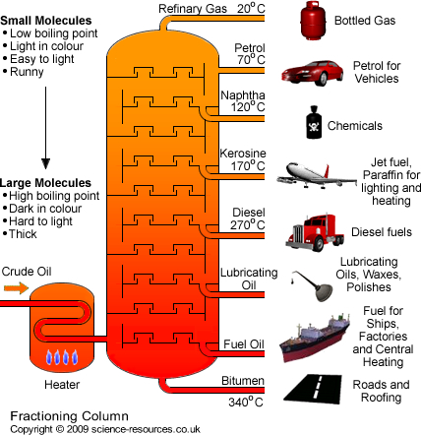
Pure substances
In chemistry a pure substance is a single element or compound, not mixed with any other substance.
A mixture is two or more elements or compounds not chemically combined.
If a substance is pure it will melt at a specific temperature. If it is impure, the melting point will be lower and over a range of temperatures.
Mixtures can be separated by physical processes

Slide 3
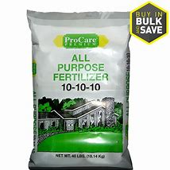
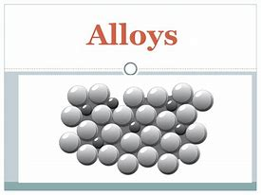
Formulations
A formulation is a mixture that
Has been designed as a useful product

Slide 4
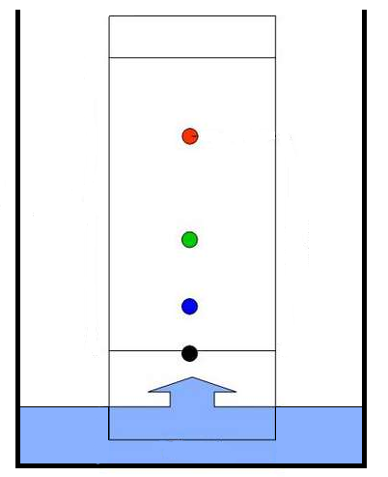
Chromatography
Separating coloured dyes or extracting small amounts of pure substances from
plants
Solvent front
Chromatography paper
dye
solvent
Base line
the line where the original sample was placed

Slide 5
Retention factor (Rf) values
The Rf factor is used to compare the components of various samples. The Rf values of suspect samples can be compared with known samples.
Rf = distance from the base line to the spot
distance from the base line to the solvent front
If two substances have the same Rf value, they are likely (but not necessarily) the same compound. If they have different Rf values, they are definitely different compounds.
Solvent front
the point at which the water stopped moving up the paper
Centre of spot
the point at which a band or spot of colour is
Base line
the line where the original sample was placed

Slide 6
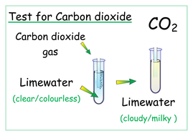
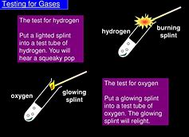
Testing for gases

