Slide 1
B6 Genetics- Paper2 Revision
Key Concepts

Slide 2
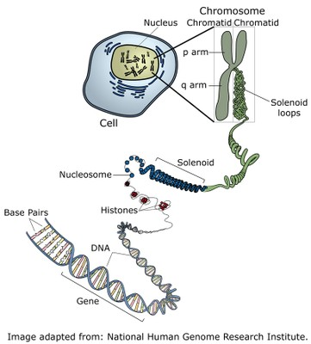
Genetic information
DNA – Deoxyribonucleic acids
Gene – Section of DNA that codes for a protein
Chromosome – made of DNA found inside the nucleus of cells
Genome – entire set of genes an organism has

Slide 3
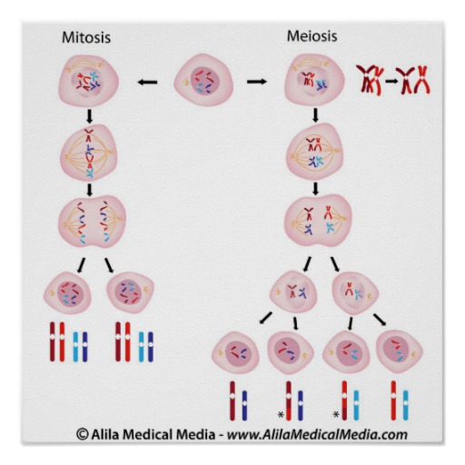
Meiosis vs Mitosis
Mitosis is used to produce genetically identical cells needed in growth and repair.
Meiosis is used to produce gametes (sex cells)
Mitosis – making two
Meiosis – making eggs

Slide 4
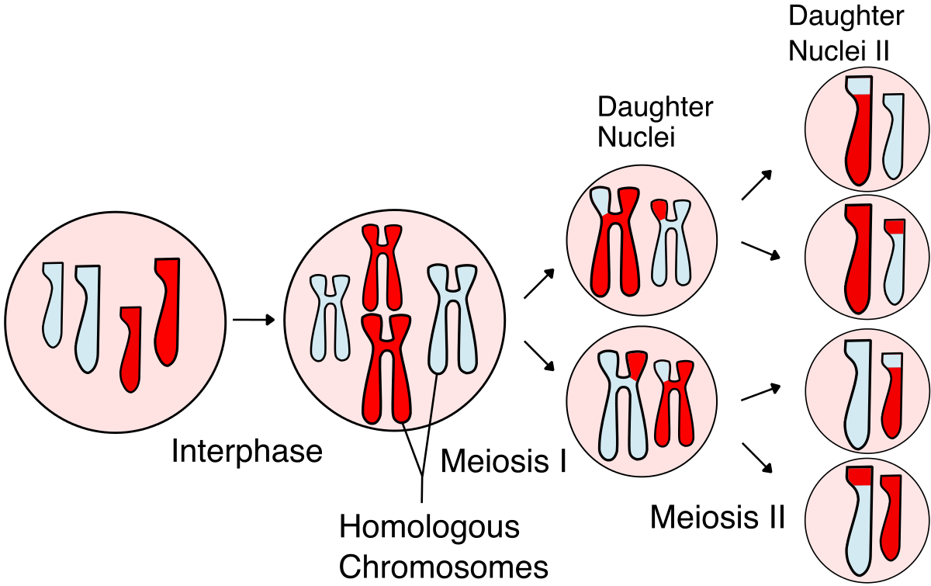
Meiosis - variation
Four daughter cells are produced each has:
Half the DNA
Genetic variation
More variation is introduced when gametes from 2 parents fuse during fertilisation.

Slide 5
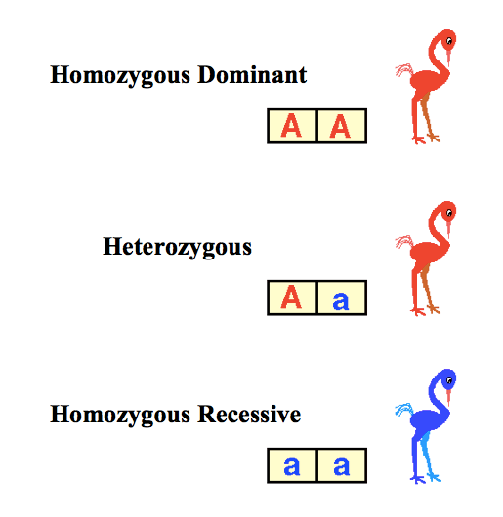
Genetic terminology
Allele – version of a gene (A or a)
Genotype – the alleles an individual has (AA, Aa or aa)
Phenotype – the physical expression of the genotype
Homozygous – both alleles are the same (AA or aa)
Heterozygous – two different versions (Aa)

Slide 6
Genetic terminology
Dominant allele – Only need one version of the allele to be present in the phenotype (AA or Aa)
Recessive allele – Need two copies of the allele of the allele for it to be present in the phenotype (aa)

Slide 7
Genetic diagrams
A
 | A | a
A | AA | Aa
a | Aa | aa
What proportion of the offspring are blue?
25% or 0.25 or 1/4

