Slide 1
B2 Photosynthesis Revision
Key Concepts

Slide 2
Photosynthesis equation + uses
Carbon Dioxide + Water → Glucose + Oxygen
6CO₂ + 6H₂O → C₆H₁₂O₆ + 6O₂
Plants use the glucose they make in photosynthesis for:
Respiration
Making starch
Making protein
Making fats
Making cellulose
Light Energy

Slide 3
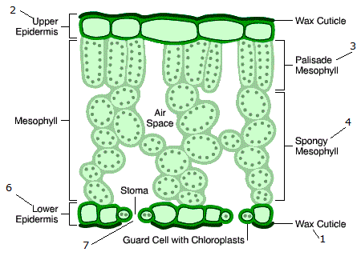
Leaf structure
Leaf tissue | Function
Upper epidermis | Waterproof + allows light through
Palisade mesophyll | Site of photosynthesis
Spongy mesophyll | Gas exchange – absorb CO₂
Guard cells | Close stomata – prevent too much water loss
Stomata | Allow CO₂ into the leaf
Xylem | Transport water to cells
Phloem | Transport sugars away from leaf

Slide 4
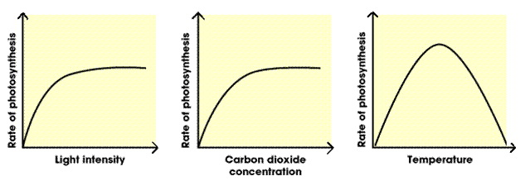
Limiting factors

Slide 5
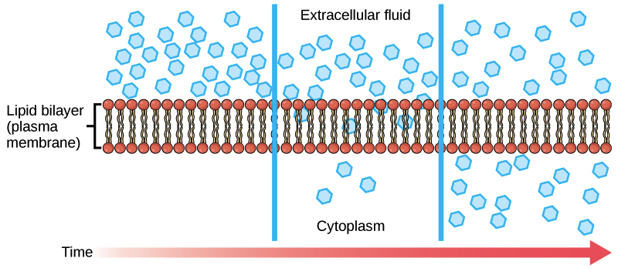
Diffusion
Definition: The movement of particles from an area of high concentration to an area of low concentration down a concentration gradient

Slide 6
Transpiration and Translocation
Transpiration: Movement of water up through the plant and its loss from the leaves
Translocation: Movement of sugars from the leaves to the roots
Xylem – transpiration
Phloem – translocation

Slide 7
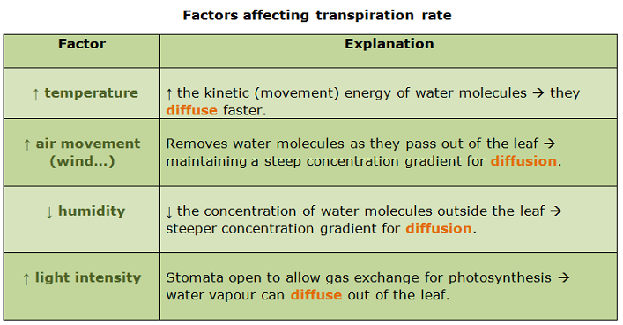
Transpiration factors

