Slide 1
B3 Moving and Changing Materials
Key Concepts

Slide 2
Diffusion, Osmosis and Active Transport
Diffusion: The movement of particles from an area high to low concentration down a concentration gradient
Osmosis: The movement of water molecules from a dilute to more concentrated solution across a semi-permeable membrane
Active Transport: The movement of dissolved ions/molecules from an area of low to high concentration using energy from respiration and carrier proteins.

Slide 3
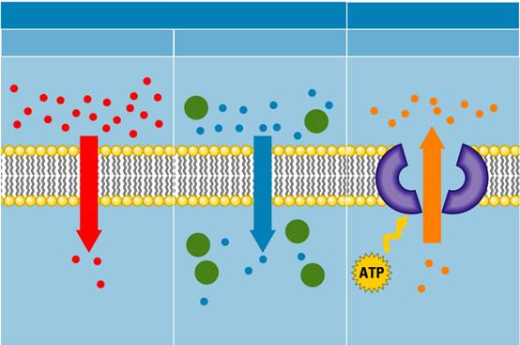
Diffusion, Osmosis and Active Transport
Diffusion
Osmosis
Active transport

Slide 4
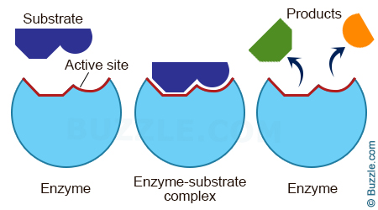
Enzymes
Biological catalysts: Made of protein and speed up chemical reactions without being used up.
Control all chemical reactions in cells e.g. respiration and photosynthesis
Examples include: amylase, protease and lipase

Slide 5
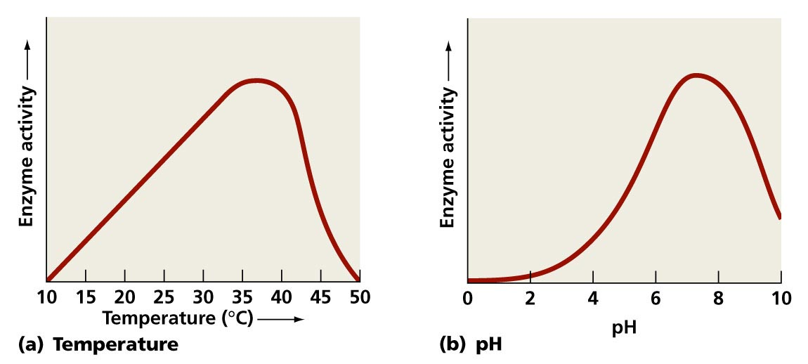
Factors that affect enzymes
Inc temp → Inc kinetic energy → More collisions between enzyme and substrate
High temperatures and extremes in pH cause enzymes to denature

Slide 6
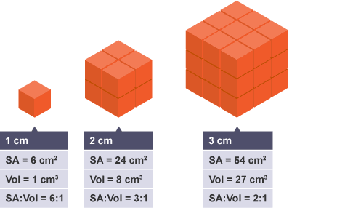
Exchange surfaces and SA:Vol
Single-celled organisms can rely on diffusion to exchange materials (high SA:Vol)
Multi-cellular organisms cannot as they have a low SA:Vol ratio
Multicellular organisms have therefore evolved exchange and transport organ systems to get round this problem

Slide 7
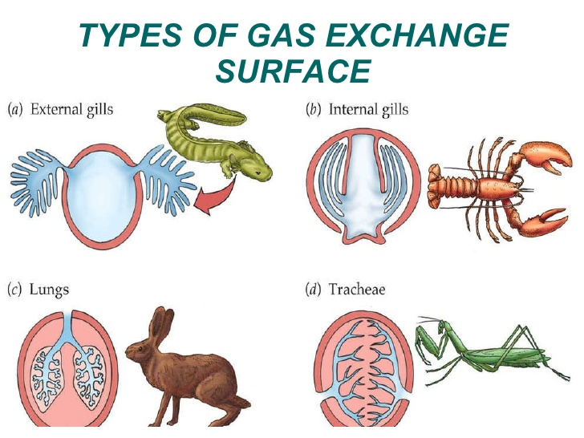
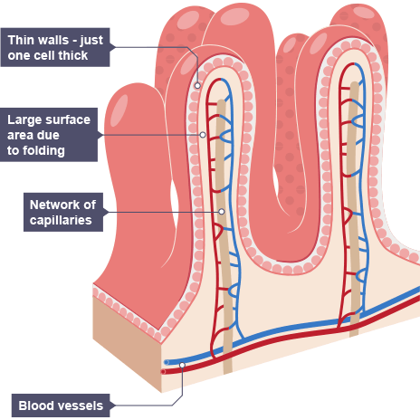
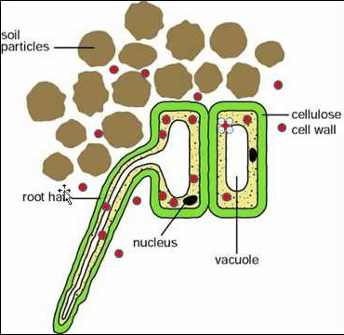
Examples of exchange surfaces

Slide 8
Exchange surfaces and SA:Vol
All exchange surfaces have these features in common:
Large surface area – increase diffusion/osmosis rate
Thin (1 cell thick) – decreases diffusion/osmosis distance
Close to a transport system (blood or xylem) – maintains steep concentration gradient

Slide 9
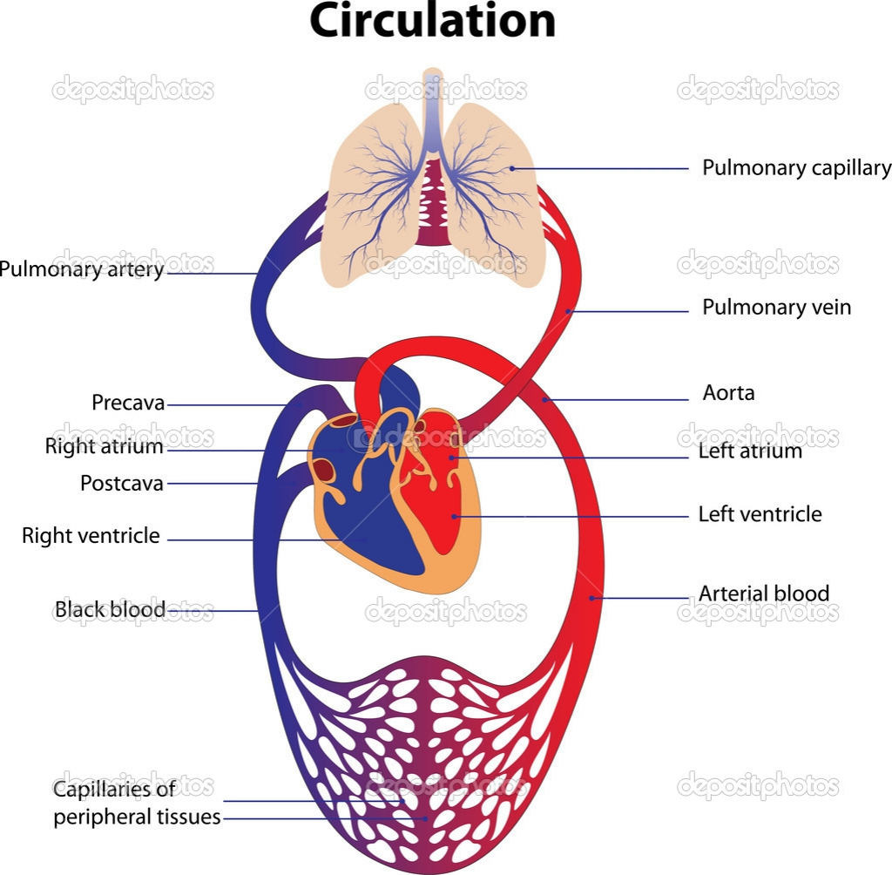
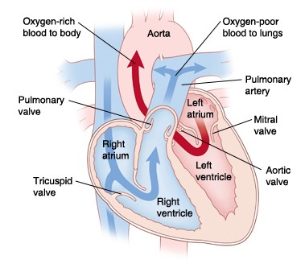
Circulatory system

Slide 10
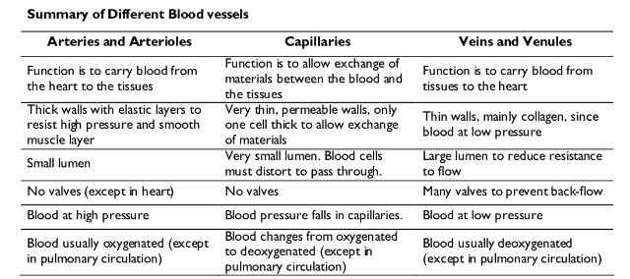
Blood vessels

