Slide 1
Keeping Healthy
Key Concepts

Slide 2
Health and Disease
Health: Complete physical and mental well being
Communicable – Diseases you can catch, caused by pathogens
Non-communicable – Diseases caused by your environment, lifestyle or genetics

Slide 3
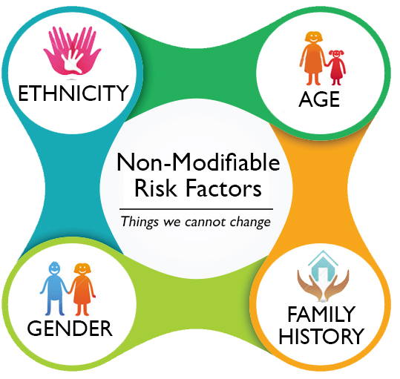
Risk factors
Increase the chance of catching a disease. These are caused by a persons lifestyle, the substances in their body and their environment e.g.:
High fat/sugar diet
Smoking
Alcohol
Sexual Habits
Carcinogens

Slide 4
Cancer
Mutation that leads to cells dividing uncontrollably to form a tumour.
Benign tumour – does not spread, easy to remove
Malignant – does spread, difficult to remove
Cancer risk factors:
Cancer risk factors
Smoking
Obesity
HPV virus
UV light
Age
Genetic causes

Slide 5
Cancer

Slide 6
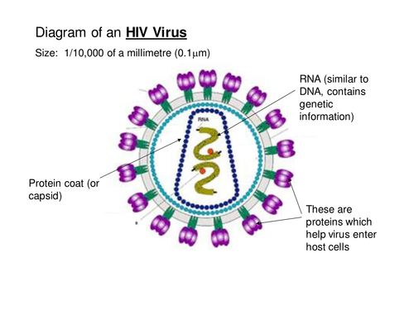
Pathogens
Pathogens are microorganisms that cause disease, these include:
Bacteria: Salmonella, gonorrhoea
Viruses: HIV, Measles, TMV
Fungi: Rose black spot
Protists: Malaria

Slide 7
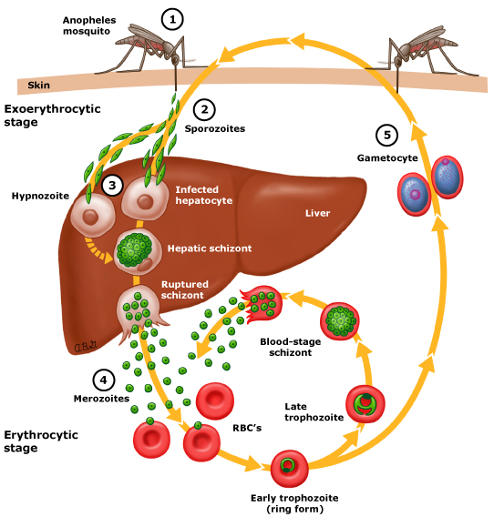
How they cause disease
Bacteria: Produce toxins that make you ill
Viruses: Take over your cells to reproduce
Malaria:
Mosquito injects malaria into the blood
Malaria then passes into the liver and multiplies
Malaria then moves into red blood cells, causes them to burst and they release toxins

Slide 8
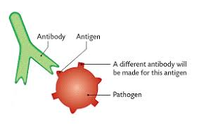
White blood cells
White blood cells defend against pathogens by:
Ingesting them
Producing antibodies
Producing antitoxins
Antibodies can cause:
Pathogen cells to burst
Bind to their surface and destroy them
Stick pathogens together

Slide 9
Vaccination
Dead pathogens injected
Lymphocytes detect antigens on the surface of pathogens
Lymphocytes ‘remember’ antigen shape
Later reinfection
Lymphocytes recognise pathogen and rapidly produce correct antibody
Pathogens killed before they make you ill - immunity

Slide 10
Types of drugs
Antibiotics are chemicals that kill bacteria (cannot be used against viruses)
Painkillers stop nerve impulses to the brain so you don’t feel the pain anymore (they do not stop the cause of pain)
Antiviral drugs do not kill viruses they slow down their viral development in the body. It is difficult to treat viruses as they live inside your cells

Slide 11
Drug testing
Stage 1: preclinical trials – cells + tissues then live animals
Stage 2: clinical trials – healthy volunteers tested on low doses
Stage 3: clinical trials – volunteers to test efficacy and side effects
Stage 4: clinical trial – larger number of volunteers top test for long-term side effects

