Slide 1
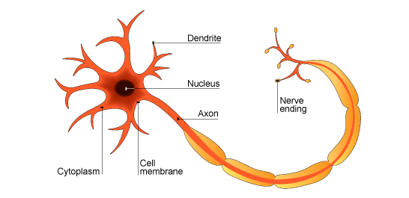
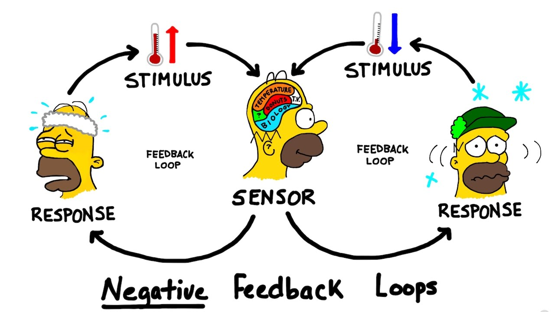
Paper 2 Biology Coordination and Control

Slide 2
Homeostasis
Definition: Maintaining a constant internal environment
What does our body need to control?
Temperature – maintain constant 37⁰C
Blood glucose concentration
Water
Salt

Slide 3
Homeostasis - control
Your body has two main control systems to ensure homeostasis is possible:
Nervous system: uses electrical impulses to communicate
Endocrine system: uses hormones to communicate
Control system
Receptor → Coordination Centre → Effector

Slide 4
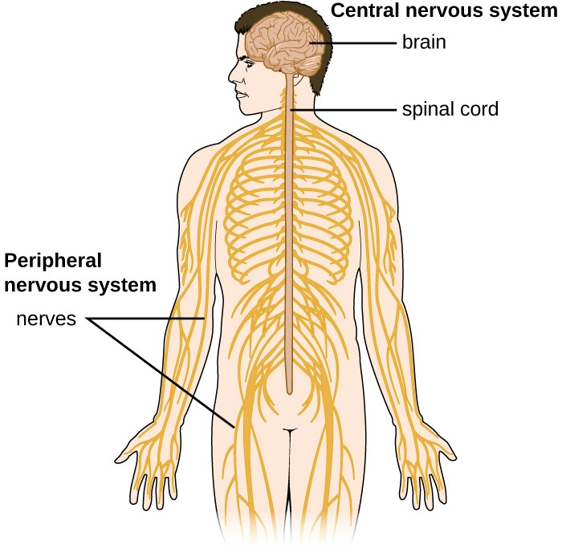
Nervous system
The nervous system enables the body to communicate, coordinate and respond.
It is made up specialised cells called neurones
The nervous system is composed of the CNS (brain and spinal cord) and peripheral nerves.

Slide 5
Neurones
Neurones are highly specialised cells, key adaptations include:
Long – connect different parts of the body
Fine branches at their tips – form connections to other neurones, receptors or effectors
There are two types:
Sensory neurone – connect receptors to CNS, impulses travel towards CNS
Motor – connect CNS to effectors (muscles or glands) impulses travel away from CNS
Motor neurone

Slide 6
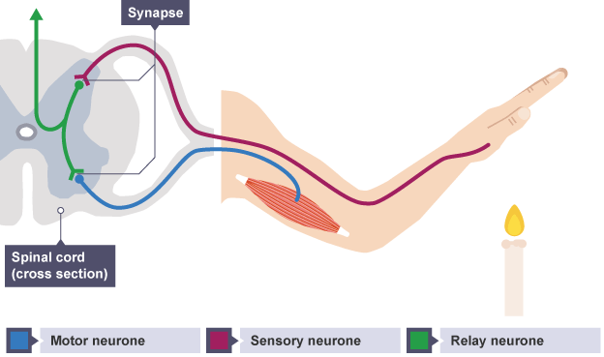
Reflex actions
Reflex – automatic, rapid response to stimuli that is designed to protect the body.
Reflex arc

Slide 7
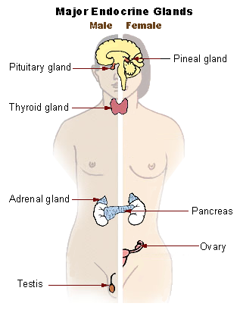
Endocrine system
Glands secrete hormones into the blood
Hormones are chemical messengers and bring about response at target organs.
Pituitary gland is sometimes called the master gland as it secretes hormones that help coordinate other glands and the hormones they secrete

Slide 8
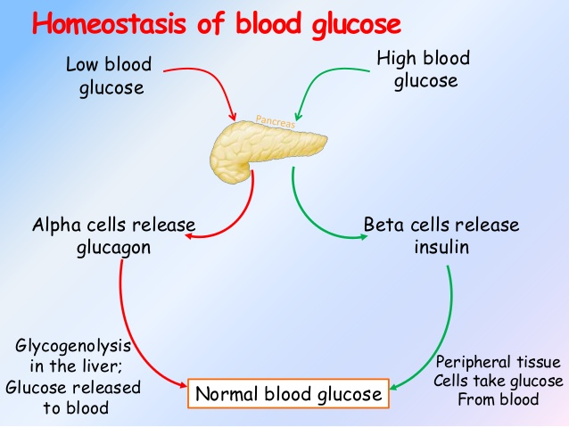
Controlling blood glucose
Pancreas – glandular tissues can detect blood glucose and release two hormones to control it:
Insulin: hormone that cells absorb glucose from blood
(Higher) Glucagon: makes cells break down glycogen into glucose and release it into the blood

Slide 9
Diabetes – Type 1
Pancreas does not release insulin.
It is caused by genetic factors or autoimmune condition
Results in high blood glucose levels, excess glucose is then urinated out.
Symptoms include: weight loss, extreme thirst, frequent urination
Treatment: Insulin injections after meals and monitoring blood glucose regularly

Slide 10
Diabetes – type 2
Caused by body cells loosing sensitivity to insulin usually through obesity and lack of exercise, but genetic factors may also contribute.
Treatment – low carbohydrate diet, more exercise, drugs to help control blood glucose levels
80% of cases are preventable
Ethical considerations: loosing weight will help people not develop type 2, but it is our right to make them? Do food manufactures have a responsibility to make food healthier?
Social considerations: should there be a sugar tax, this could pay for treatment. On the other hand this could affect people who could least afford it, diabetes is more common in most deprived component of the UK population

Slide 11
Negative feedback – higher only
The endocrine system controls processes and homeostatic mechanisms though negative feedback, it does so to prevent systems becoming too overactive.
Pituitary gland
Secretion
Inhibition
Thyroid stimulating
hormone (TSH)
Thyroid gland
Levels too low
Thyroid hormone
Levels too high
Target cells

Slide 12
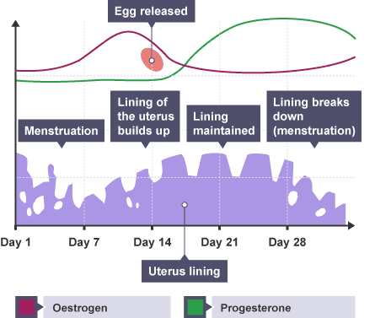
Human reproduction – menstrual cycle
Menstrual cycle – hormone controlled cycle that coordinates the female reproduction system to prepare for pregnancy

Slide 13
Human reproduction – menstrual cycle
Menstrual cycle hormones
Hormone | Where is it produced? | What does it do? | Does it affect other hormones?
FSH | Pituitary gland | Stimulates eggs to mature | Stimulates oestrogen production
LH | Pituitary gland | Stimulates ovulation | Stimulates progesterone production
Oestrogen | Ovaries | Thickens lining of uterus | Inhibits FSH
Progesterone | Ovaries | Maintains uterus lining (if pregnant) | Inhibits FSH and LH

Slide 14
IVF – higher only
IVF – in-vitro fertilisation
Process:
Women give FSH and LH to stimulate production of many eggs
Eggs collected surgically
Eggs mixed with sperm, over a 16-20 hour period sperm fertilise eggs
Embryos allowed to develop for 5 days (100 cells in size)
Healthy embryos selected and implanted into the mothers uterus

Slide 15
IVF evaluation – Higher only
IVF has a low success rate 32% or less, and decreases with age
IVF problems: more likely to have:
Premature babies
Still births
Low birth weights
Ethical issues – removes natural obstacles to fertility, which embryo should be selected or discarded?

Slide 16
Systems working together – higher only
Adrenaline is a hormone that stimulates a fight or flight response.
The nervous system detects a dangerous stimulates and the brain (coordinator) sends impulses to the adrenal gland, these release adrenaline into the blood. Adrenaline then many target organs such as the heart, lungs and liver.
Adrenaline increases heart rate, breathing rate and the breakdown of glycogen in the liver, all these increase the amount of oxygen and glucose for muscle cells so they can respire more.

Slide 17
Contraception
Two core methods:
Barrier methods: uses a physical barrier to prevent sperm reaching egg e.g. condoms and diaphragm
Hormonal: oestrogen and progesterone or progestogen only pills that prevent the release of the eggs so sperm cannot fertilise them.

Slide 18
Contraceptives
Method | Advantages | Disadvantages | Percentage of pregnancies prevented
Condoms | Widely available Protect against STDs | May slip off Must withdraw after ejaculation | 98
Diaphragm | Put in before sex No health risks | Needs to be kept in for several ours after sex Some people are sensitive to spermicide | 92-96
Oral contraceptives | Highly effective Reduce the risk of certain cancers | Need to be take regularly (you may forget) Possible side effects | >99
IUD | Works immediately Can stay in place for 10 – 5 years | Insertion may be painful Periods may be longer and more painful | >99

