Slide 1
B7 Variation and Evolution- Paper2 Revision
Key Concepts

Slide 2
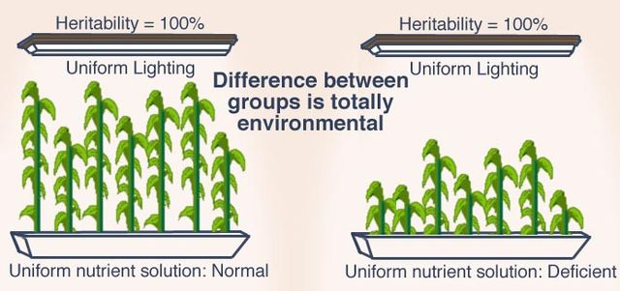
Variation
Variation – differences between organisms or individuals (e.g. height)
Genetic variation- inherited features that are controlled by genes (e.g. eye colour)
Environmental variation – features caused your development (e.g. scars)
Both – (e.g. body mass)

Slide 3
Natural selection and evolution
Evolution – How organisms have changed form simple to more complex forms over millions of years
Natural selection – the process by evolution occurs where more advantageous genes increase in frequency in a population over time

Slide 4
Natural selection
Disadvantageous genes
Die
Selection
pressure
Mutation
Advantageous genes
Survive + Reproduce
Advantageous genes
increase in frequency in the population
Pass on genes
to offspring

Slide 5
Evidence for evolution and natural selection
Fossils – show organisms have changed from simple to more complex forms over millions of years
Peppered moths – show natural selection action as dark forms were selected for during the industrial revolution
Antibiotic resistant bacteria – show that bacteria have rapidly evolved resistance to the misuse of antibiotics through natural selection
DNA evidence – Shows that all organisms are related and are part of the ‘tree of life’.

Slide 6
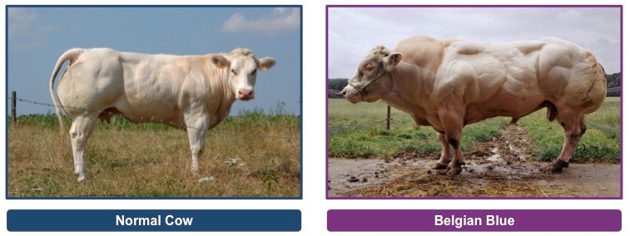
Selective breeding
Select individuals with required trait and breed them (e.g. more muscle)
Select offspring with required trait (e.g. more muscle) and breed them.
Repeat over many generations until all individuals have the desired trait (e.g. more muscle)

Slide 7
Genetic engineering - bacteria
Genetic engineering – animal or plant
Remove target gene from
chromosome using an enzyme
Remove target gene from
chromosome using an enzyme
Cut open plasmid using enzyme
Splice target gene in chromosome using enzyme
Splice target gene in plasmid using enzyme
Insert modified chromosome into embryo
Insert plasmid into bacterium

