Slide 1
C9: The Atmosphere
Key Concepts

Slide 2
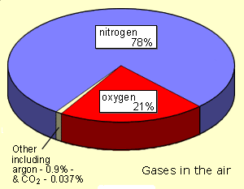
Proportions of gases in the atmosphere

Slide 3
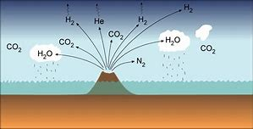
The Earth’s Early Atmosphere
Scientists believe that the Earth was formed about 4.5 billion years ago. Its early atmosphere was probably formed from the gases given out by volcanoes. It is believed that there was intense volcanic activity for the first billion years of the Earth's existence.
The early atmosphere was probably mostly carbon dioxide with little or no oxygen. There were smaller proportions of water vapour, ammonia and methane. As the Earth cooled down, most of the water vapour condensed and formed the oceans.

Slide 4
Changing atmosphere
Increasing oxygen
Plants and algae can carry out photosynthesis. This process uses carbon dioxide from the atmosphere (with water and sunlight) to produce oxygen (and glucose). The appearance of plants and algae caused the production of oxygen, which is why the proportion of oxygen went up.
Decreasing carbon dioxide
Photosynthesis by plants and algae used carbon dioxide from the atmosphere, but this is not the only reason why the proportion of carbon dioxide went down. These processes also absorb carbon dioxide from the atmosphere:
dissolving in the oceans
the production of sedimentary rocks such as limestone
the production of fossil fuels from the remains of dead plants and animals
Today, the burning of fossil fuels (coal and oil) is adding carbon dioxide to the atmosphere faster than it can be removed. This means that the level of carbon dioxide in the atmosphere is increasing, contributing to global warming. It also means that the oceans are becoming more acidic as they dissolve increasing amounts of carbon dioxide. This has an impact on the marine environment, for example making the shells of sea creatures thinner than normal.

Slide 5
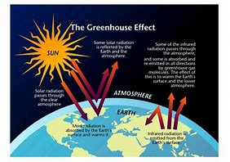
The Greenhouse Effect
The greenhouse effect
Some gases in the Earth’s atmosphere stop heat radiating into space from the Earth. This is called the greenhouse effect and the gases involved are called greenhouse gases. They include:
methane
water vapour
carbon dioxide.
Electromagnetic radiation at most wavelengths from the Sun passes through the Earth’s atmosphere.
The Earth absorbs electromagnetic radiation with short wavelengths and so warms up.
Heat is radiated from the Earth as longer wavelength infrared radiation.
Some of this infrared radiation is absorbed by greenhouse gases in the atmosphere.
The atmosphere warms up.

Slide 6
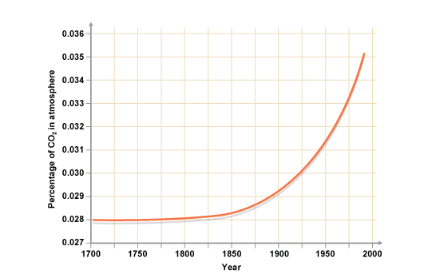
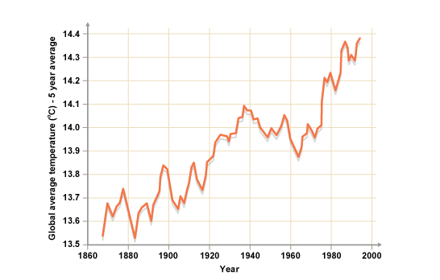
Human Activites
Greenhouse gas | Natural source | Man-made source
Methane | Decomposing plant material | Rice paddy fields, cattle, coal mines
Water vapour | Evaporation from oceans, lakes and rivers | Burning hydrocarbon fuels
Carbon dioxide | Respiration by plants and animals, forest fires, volcanoes | Making cement, burning fossil fuels

Slide 7
Carbon footprint
A carbon footprint is a measure of the impact our activities have on the environment. It calculates all the greenhouse gases we are expected to produce in all our activities and measures them in units of carbon dioxide.
Reducing Carbon footprints:
Carbon capture and storage is the process of capturing waste carbon dioxide from large point sources, such as fossil fuel power plants, transporting it to a storage site, and depositing it where it will not enter the atmosphere
carbon offsetting. a program in which a company, country, etc., reduces or offsets its carbon emissions through the funding of activities and projects that improve the environment:
Carbon neutrality, or having a net zero carbon footprint, refers to achieving net zero carbon emissions by balancing a measured amount of carbon released with an equivalent amount sequestered or offset, or buying enough carbon credits to make up the difference.

Slide 8
Atmospheric Pollutants From Fuels
Burning fuels releases harmful pollutants into the air. Pollutants can kill plants, harm our lungs, cause acid rain and are thought to contribute to global warming.
Fuels are burned in the vehicles we use for transport, and in power stations to make electricity. When fuels are burned, pollutants are formed and released into the air.This combustion of fuels increases the concentration of carbon dioxide in the air. This is thought to cause global warming.
Many fuels contain small amounts of sulfur compounds. When these fuels are burned sulfur dioxide is released into the air. Sulfur dioxide causes acid rain which can damage buildings and kill plants.
If there is not enough oxygen present to burn the fuels completely, incomplete combustion takes place. Carbon monoxide, a very poisonous gas, is formed.
Incomplete combustion also releases very small particles of carbon into the air. This particulate carbon makes buildings dirty and can cause breathing difficulties.
In the high temperatures of vehicle engines, nitrogen and oxygen react to form nitrogen oxides. These gases irritate the lungs and cause acid rain.

