Slide 1
Electromagnetism
Key concepts

Slide 2
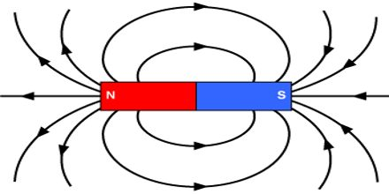
Magnetism and Magnetic forces
The poles of a magnet are the places where the magnetic forces are the greatest.
The magnetic field is the region around a magnet where a force acts on another magnet or on a magnetic material.
An induced magnet is a material that becomes a magnet temporarily when it is placed in a magnetic field.
Permanent magnets are made of nickel, cobalt and some types of steel.

Slide 3
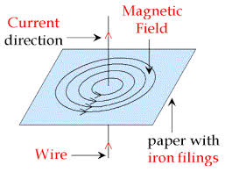
Magnetic Fields
The closer the field lines the greater the strengthen of the magnetic field
The strength of the magnetic increases with
Current
Voltage
Right Hand Rule
The thumb indicates the direction of the current
Fingers point to the direction of magnetic field.

Slide 4
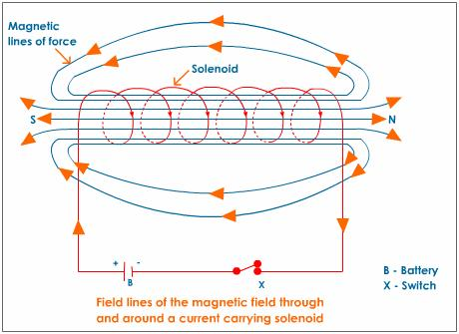
Magnetic effect of a solenoid
A solenoid is a long straight coil of wire.
When current is passed through a solenoid it produces a magnetic field.
Adding a iron core increases the strength of the magnetic field to make it a electromagnet.

Slide 5
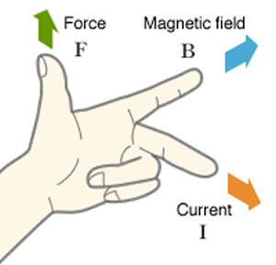
Higher Only
Fleming’s left hand rule
Thumb shows the direction of motion of the wire
First finger in the direction of magnetic field
Second finger in the direction of current
The force on the wire can be increased by
Increasing the size of the magnetic field
The current passing through the wire
The length of the wire that is in the magnetic field.

Slide 6
Magnetic Flux
Magnetic flux tells us about the strength of a magnetic field.
Force on a wire
The size of the force (N) on a wire carrying a current at right angles to a magnetic field is proportional to the current (A) and length of wire (m).
F = BIL
B = magnetic flux density, in tesla(T).
I = Current (A)
L = Length (m).

