Slide 1
Forces
Force is a push or pull that is applied by one object on another.
Force is measured in newtons (N).
Two types of forces
Contact and Non-contact forces
Contact Forces | Non-contact forces
friction | Gravitational force
Air resistance | Electrostatic force
tension | Magnetic force

Slide 2
Scalar and Vector quantities
A scalar quantity has magnitude (size) only.
A vector quantity has magnitude and direction.
Example force is a vector quantity, where the arrow represents the direction and length of the arrow represents the magnitude.
Scalar | Speed, distance
Vector | Velocity, displacement

Slide 3
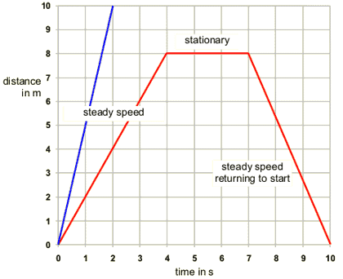
Speed
Speed tells us how fast something is moving.
Speed = distance
time

Slide 4
Acceleration
When the velocity of the car is increasing it is accelerating. When the velocity of the car is decreasing it is decelerating.
Acceleration = change in velocity ÷ time taken

Slide 5
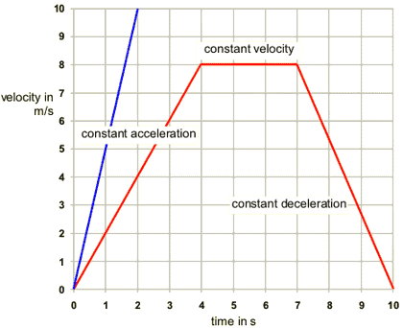
Velocity Time graphs

Slide 6
Calculations of motion
Initial velocity – The velocity of an object at the start.
Final Velocity – The velocity of an object at the end of the acceleration.
Calculating Motion: V² – U² = 2as
v = final velocity (m/s)
u = initial velocity (m/s)
a = acceleration (m/s²)
s = displacement (m)
If there is no air resistance and an object is falling it has a acceleration of 9.8 m/s². If an object is thrown upwards it decelerates and has an acceleration of -9.8 m/s².

Slide 7
Resultant force –single force that would have the same effect on an object as all the forces that are acting on the object.
If the resultant forces are zero, the object will be in equilibrium.

Slide 8
Newton’s Laws
Newton’s First law – states that if the resultant force acting on an object is zero, it will
Remain stationary if it’s stationary and will be moving if it’s at a steady speed in a straight line.
Newton’s Second law states that resultant force equals mass times acceleration.
Force = mass X acceleration
Newton’s third law states that whenever two objects interact, the forces exerted are equal and opposite.

Slide 9
Keeping safe on the road
Reaction Time – time taken for the driver to react to a stimulus
Thinking distance – distance travelled during the reaction time.
Braking distance – distance travelled before a car stops.
Stopping distance = thinking distance + braking distance.
Factors that affect stopping distance
Tired, influence of alcohol or drugs, concentration.
Braking distance increases – road is wet or icy, poor brakes or bald tyres and speed of the car.

Slide 10
Forces and energy in springs
A spring extends when a force is applied to it.
Force = spring constant X extension
Elastic potential energy = 0.5 X spring constant X extension²

Slide 11
Higher Only
Free body diagrams
Inertia – massive objects can be hard to move and hard to stop examples cruise ships, airplanes. This reluctance to move is called inertia.
Inertia mass = force ÷ acceleration
Momentum – a moving object has got momentum. The amount of momentum depends on the mass and velocity.
Momentum = mass x velocity.

