Slide 1
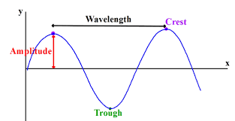
Waves
Waves transfer energy. Example – light and sound waves.
Wavelength(λ) – Distance between two crest, measured in meters.
Frequency (f) – the number of complete
Waves passing a point in 1 second.
Measured in hertz (Hz).
Time period (T) – time to complete one
Wavelength.
T = 1 ÷ f
Wave speed = frequency x wavelength.

Slide 2
Transverse and Longitudinal Waves
Transverse and Longitudinal wave properties.
Transverse Waves | Longitudinal waves
The vibrations are at right angles. | The vibrations are parallel
The particles move up and down vertically. | The particles move side to side horizontally.
The energy is carried away from the source. | The waves show areas of compression and rarefactions
Example Electromagnetic Spectrum | Example sound

Slide 3
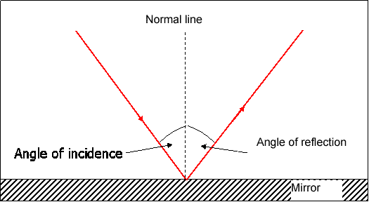
Reflection
Reflection of wave
Angle of incidence equals the angle of reflection

Slide 4
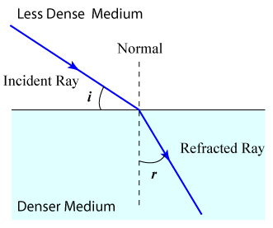
Refraction
Refraction of wave takes place when the wave enters a different medium.
Example from air to glass or air to water.

Slide 5
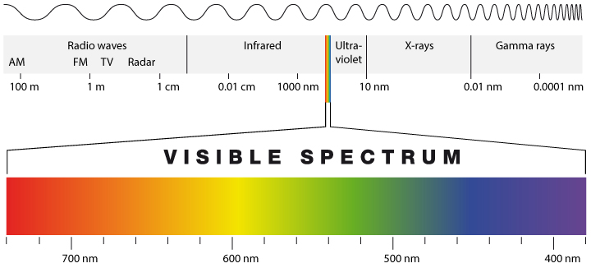
Electromagnetic Spectrum
White light is a mixture of waves with different wavelengths.

Slide 6
Electromagnetic wave uses
Radio waves travel at the speed of light. Used by TV and radio.
Microwaves are used by mobile phone signals.
Microwaves are radio waves with short wavelengths between 1mm and 30cm.
UV rays – small doses help us with Vitamin D.
Infrared radiation have longer wavelengths than red light. Used by remote controls.
Gamma rays have shortest wavelengths and used to kill cancer cells.

Slide 7
Higher Only
Wavelength dependence – proportion of wave’s energy that is reflected or absorbed depends on the wavelength and the medium it enters.
All electromagnetic waves refract – shorter the wavelength the bigger the refraction.
Wave front – is a line that joins all the points on a wave. The wave front is at right angles to the direction of the wave.

