Slide 1
Physics Paper 1
May 23rd 2018

Slide 2
Energy
What types of energy?
Light, sound ,heat, kinetic, electrical, gpe, elastic potential, chemical.
What is the equation for gravitational potential energy?
GPE = mass x height x gravitational field strength
What is the equation for kinetic energy?
KE = ½ x mass x velocity²
What happens to the gravitational potential energy of an object as it falls?
Changed into kinetic energy.

Slide 3
Energy
What is work done?
When a force acts on an object and the object moves.
What is the equation for work done?
W = F x s
What are the units for work done?
Joules (J)
What are the units for force?
Newtons (N)

Slide 4
Energy
What is power?
Work done per second
What are the two equations for power?
Power = work done ÷ time
Power = energy transfer ÷ time
What are the units for power?
Watt (W)
Define specific heat capacity?
The energy needed to raise the temperature of 1kg of material by 1°C
The equation for specific heat capacity is given to you on the data sheet.
Energy transfer = mass x shc x temperature change

Slide 5
Energy
How can you reduce friction?
Lubrication eg oil
What is insulation?
A way to reduce heat loss eg loft insulation
What is energy dissipation?
Energy transferred as waste energy to the environment.
What is the equation for energy efficiency?
Efficiency = useful output ÷ total input

Slide 6
Energy
What is the law for the conservation of energy?
Energy cannot be created or destroyed, only transferred.
What are non-renewable energy resources?
Energy resources that will run out eg coal, oil, gas and nuclear
What are renewable energy resources?
Energy resources that will not run out eg solar, wind, wave, tidal, hydroelectric, geothermal, biofuels.

Slide 7
Energy transfers
What are the energy transfers involved in the following?
Eg A drill?
Electrical → kinetic + sound + heat
A TV?
Electircal → light + sound + heat
Mobile phone?
Chemical → electrical → light + sound + heat
Fan Heater?
Electrical → heat + kinetic + sound

Slide 8
Electricity – symbols
Cell
Closed Switch
Variable resistor
Ammeter
Open Switch
Led
Thermistor
Battery
Fuse
Bulb
Light dependent resistor
Diode
Resistor
Voltmeter

Slide 9
Electricity
What is potential difference?
The energy transferred per unit charge
What is the equation for potential difference ?
V = IR
What is moving around the circuit?
Electrons
What is a series circuit?
A circuit that has one path for the electrons to flow
What is a parallel circuit?
A circuit that has more than one route for the electrons to flow.

Slide 10
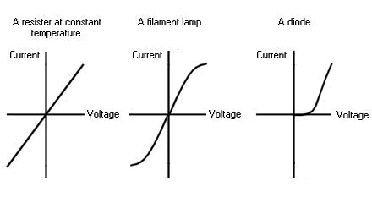
Electricty
How do you calculate resistance in a series circuit?
Add the values of the resistors together
What happens to the resistance in a parallel circuit?
The total resistance in a parallel circuit is always smaller than the smallest resistance of any component
What does the IV graph look like for a resistor, a bulb and a diode?

Slide 11
Electricity
What is a thermistor?
A temperature dependent resistor
What is an LDR?
A light dependent resistor
What is a diode?
A component that only allows current to flow in one direction

Slide 13
Electricity
What is the voltage and frequency of the domestic electricity supply in the UK?
230V and 50Hz
How is electricity transferred from power stations to your house?
National grid
How do they change the potential difference of the electricity in a power station to the pylons?
Step up transformer
How do they change the potential difference from the pylons to your house?
Step down transformer

Slide 14
Electricity
What is the equation to work out the energy transferred by electrical work?
E = QV (Q = charge flow)
What are the two equations to work out power?
P = VI P = I²R
What is the difference between potential difference and current?
Current is the flow of charge
Potential difference is the work done in moving that charge

Slide 15
Particle model of matter
What are the properties of a solid?
Fixed shape as the particles vibrate and cannot change position. Held together by a strong force of attraction called bonds.
What are the properties of a liquid?
Fixed size but no fixed shape. The bonds between the particles are less strong.
What are the properties of a gas?
No fixed shape or volume. There is virtually no force of attraction between the particles.
What is the definition of density?
The measure of the amount of substance per unit volume.

Slide 16
Particle model of matter
What is the equation for density?
Density = mass ÷ volume

Slide 17
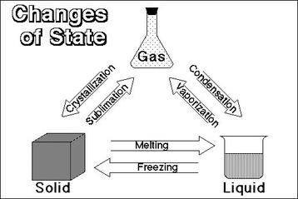
Particle model of matter

Slide 18
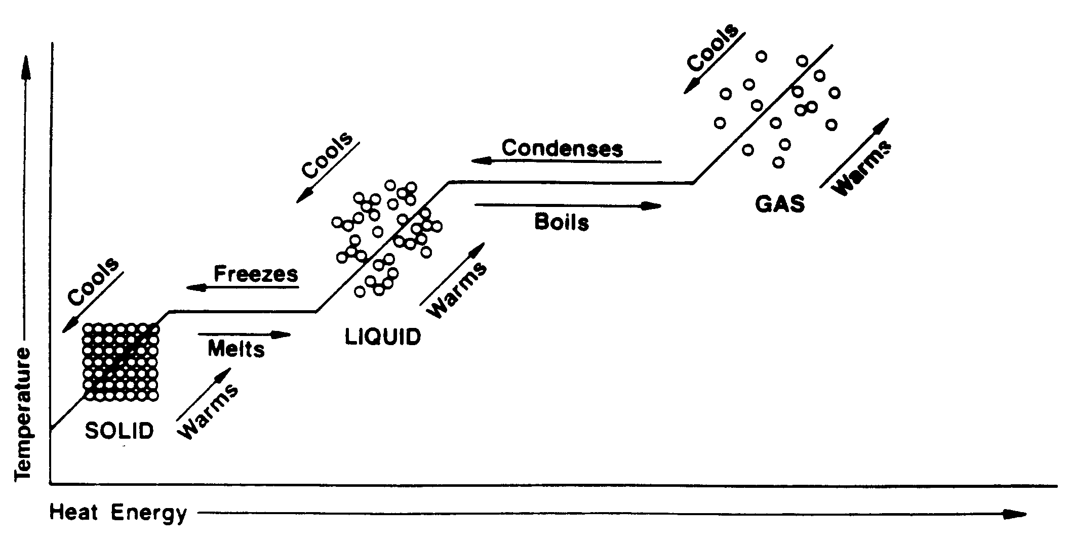
Particle model of matter

Slide 19
Particle model of matter
What is internal energy?
The total kinetic and potential energy of all the particles in a system.
How does temperature affect the internal energy of a system?
The hotter the material the more energy the system has.
What is latent heat?
The energy needed for a substance to change state.
What is specific latent heat?
The energy needed to change the state of 1kg of material.

Slide 20
Particle model of matter
What is the equation for specific latent heat?
E = mL.
What is the specific latent heat of vaporisation?
The energy needed to change the state from a liquid to a gas.
What is the specific latent heat of fusion?
The energy needed to change the state from a solid to liquid.
What is gas pressure?
The total force exerted by all the molecules inside a container.

Slide 21
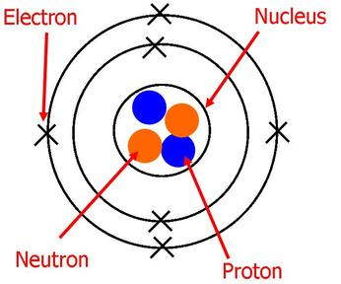
Atomic Structure
What is the structure of an atom?

Slide 22
Atomic Structure
What is radioactive decay?
When an unstable atom decays to become more stable.
What is an atom with an unstable nucleus called?
A radioisotope
What is an alpha particle?
2 protons and 2 neutrons
What is a beta particle?
A fast moving electron
What is a gamma ray?
A ray of energy that has no mass or charge

Slide 23
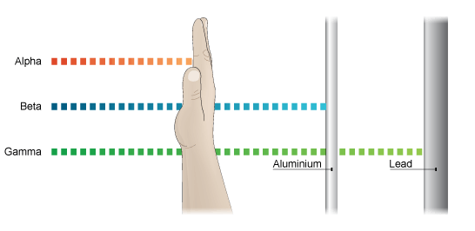
Atomic structure – properties of radiation – penetration power

Slide 24
Atomic structure
Which type of radiation is the most ionising?
Alpha
Which type of radiation is the least ionising?
Gamma
What is radioactive contamination?
The unwanted presence is materials containing radioactive atoms
What is irradiation?
When a material is exposed to nuclear radiation

Slide 25
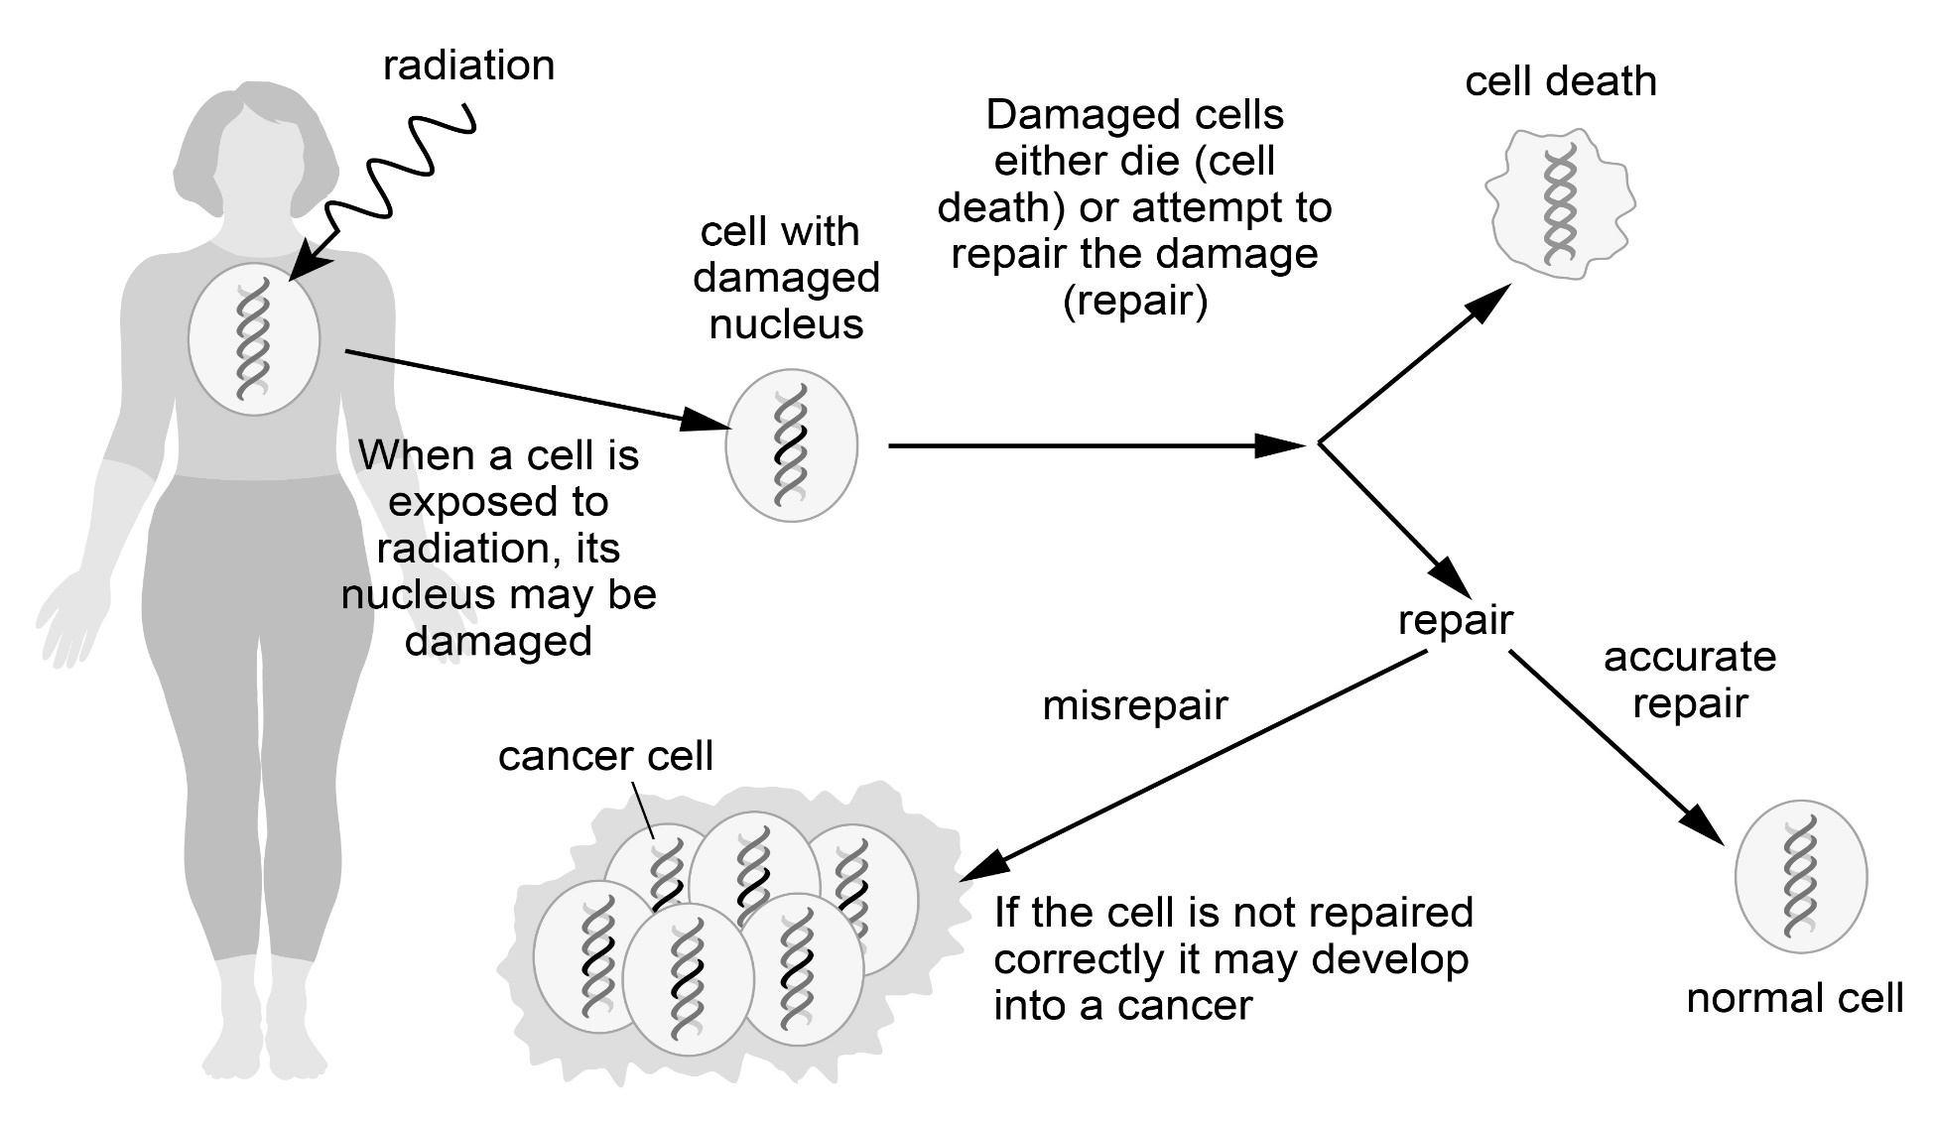
Atomic structure
What are the effects of irradiation?

Slide 26
Atomic structure
What is a half life?
The time taken for the radioactivity of a material to fall by half
What is the plum pudding model of the atom?

