Slide 1
P2 REVISION
Key knowledge

Slide 2
What is meant by a scaler?
A quantity that has magnitude (size) only
What is meant by a vector?
A quantity that has both magnitude and direction.
Are forces a vector or scaler quantity?
Forces are vectors, because they have both size and direction.
What is meant by a contact force?
This is when objects are physically touching. e,g friction
What is meant by a non-contact force.
This is when objects are not physically touching. e.g gravity

Slide 3
What is meant by weight?
Weight is the force of gravity acting on an object.
What is the equation for weight?
Weight = mass x gravitational field strength.
What is the gravitational field strength on Earth?
10N/kg
What is the weight of 750kg car on Earth?
750 x 10 = 7500N
What is used to measure forces?
Newton meter.

Slide 4
What is the resultant force (HT)?
(2+ 1.5) – 3 = 0.5N to the left.
A spring can be extended or compressed by forces, what does this mean?
Extended means be stretched, compressed means to be squashed.
What is meant by elastic deformation of a spring?
The spring returns back to its original length when the forces are removed.

Slide 5
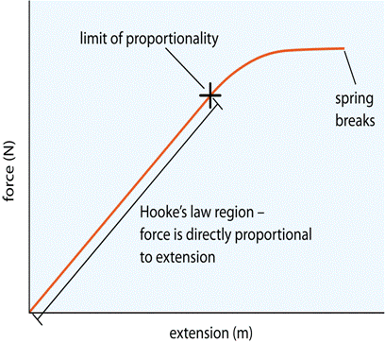
What is the equation for stretching a spring?
Force = spring constant x extension.
What is meant by the limit of proportionality of a spring?
The point beyond which the extension is no longer proportional to the force.

Slide 6
How would you calculate the elastic potential energy stored in a spring?
Elastic potential energy = 0.5 x spring constant x (extension)².
What is the difference between speed and velocity?
Speed is a scalar quantity it only has size, velocity is a vector quantity it is the speed in a given direction .
What is a change of speed or velocity called?
Acceleration
What is the equation of acceleration?
Acceleration = change in velocity/time taken
What is the unit for acceleration?
m/s².

Slide 7
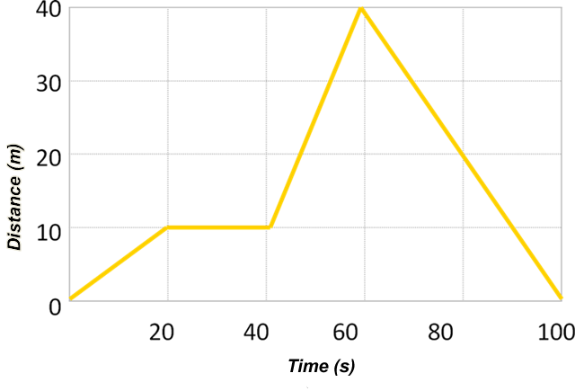
What does a upwards slope show?
A constant speed
What does the flat part of the graph show?
Stopped/not moving

Slide 8
What does a steeper slope show?
A faster constant speed
How could you calculate the speed?
The gradient of the slope.

Slide 9
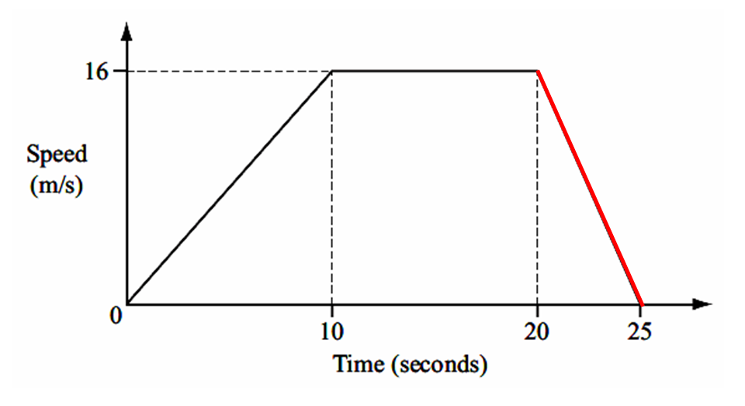
What is the maximum speed?
16m/s
What is the acceleration?
16/10 = 1.6m/s²

Slide 10
What is the deceleration?
16/5 = 3.2m/s²
How do you calculate the distance travelled?
Area under the graph.

Slide 11
State Newton’s 1st Law.
If the resultant force acting on an object is zero and:
the object is stationary, the object remains stationary
the object is moving, the object continues to move at the same speed and in the same direction. So the object continues to move at the same velocity.
When a vehicle is moving at a steady speed what does that tell us about the forces acting on it?
They are balanced.
State Newton’s 2nd Law.
The acceleration of an object is proportional to the resultant force acting on the object, and inversely proportional to the mass of the object.
Force = mass x acceleration

Slide 12
State Newton’s 3rd Law?
Whenever two objects interact, the forces they exert on each other are equal and opposite.
Stopping Distance equals?
Thinking Distance + Braking Distance
Thinking Distance is defined as.
The distance travelled during the reaction time.
Braking Distance is defined as.
The distance travelled whilst braking.
What factors increase thinking distance.
Alcohol, Tiredness, Drugs, Speed, Distractions

Slide 13
What factors increase braking distance?
Ice, poor brakes, bald tyres, speed.
How would you calculate the momentum of an object?
Momentum = mass x velocity
What is meant by the conservation of momentum?
The momentum before a collision or explosion equals the momentum after a collision or explosion.

Slide 14
What do waves transfer?
Waves transfer energy from one place to another.
Describe the movement of particles in a transverse wave.
Particles vibrate at 90^{O} to the direction the wave is travelling.
Describe the movement of particles in a longitudinal wave
Particles vibrate parallel to the direction the wave is travelling.
Which type of wave has compressions and rarefactions?
Longitudinal waves.
What type of wave is a sound wave?
Longitudinal.

Slide 15
What is meant by the wavelength of a wave?
The distance from a point in one wave to the equivalent point on the adjacent wave.
What is meant by the amplitude of a wave?.
The maximum displacement of a point of a wave from its undisturbed position.
What is meant by the frequency of a wave?
The number of complete waves passing a point in 1 second..
What is frequency measured in?
Hertz (Hz).
What is 1/frequency?
Time period.

Slide 16
What is the wave equation?
Wave speed = frequency x wavelength
What are the properties of all waves?
Can be:
Reflected
Refracted
Diffracted (spread out when they go through a gap)
List the order of electromagnetic waves.
Radio, microwaves, infrared, visible, ultraviolet, x-ray, gamma rays
What do all electromagnetic waves have in common?
Transverse waves
Travel at the same speed 300,000,000m/s
Can travel through a vacuum.

Slide 17
Give a practical application of radio waves?
Radio and TV.
Give a practical application of microwaves?
Satellite communications, cooking food.
Give a practical application of infrared?
Electrical heaters, cooking food, infrared cameras .
Give a practical application of visible light?
Fibre optic communications
Give a practical application of ultraviolet?
Energy efficient lamps, sun tanning
Give a practical application of x-rays and gamma waves?
medical imaging and treatments.

Slide 18
What three things happen when a wave meets a boundary?
Reflected, absorbed and transmitted.
What is the name of the dashed line drawn at 90º to a boundary?
The normal.
What is the law of reflection?
Angle of incidence = Angle of Reflection.
What type of image is produced by a mirror?
Virtual Image.
When a wave enters a different medium what occurs?
Refraction.
What causes refraction ?
Waves changing speed.

Slide 19
Where are the magnetic field strongest on a magnet?
At the poles.
When two north poles of a magnet are brought together what happens?
They repel.
How can you make two magnets attract each other?
Bring a North and a South pole together.
What is meant by a magnetic field?
The region around the magnet where a force acts on a magnet or on a magnetic material,
Name four materials that are attracted to a magnet.
Nickel, cobalt, steel and iron

Slide 20
How is iron different from the other magnetic materials?
It loses its magnetism when the magnetising force is removed.
What is meant by a permanent magnet?
A magnet that produces its own magnetic field.
What is meant by an induced magnet?
A material that becomes a magnet when placed in a magnetic field, but loses its magnetism when it has been removed.
What is produced when a current flows through a wire?
A circular magnetic field,
How could you make this magnetic field stronger?
Larger current.

Slide 21
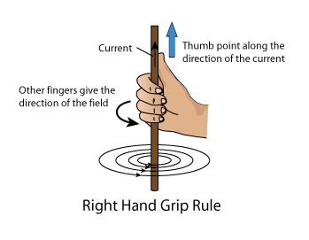
What happens if you reverse the direction of the current?
The direction of the magnetic field reverses.
What is given by the right-hand grip rule?
The direction of the magnetic field.

Slide 22
What is the name of a long coil of wire?
A solenoid.
The magnetic field produced by a solenoid is similar to what ?
A bar magnet.
How can you increase the strength of a magnetic field produced by a solenoid?
Add an iron core inside the solenoid.
Increase the current
Increase the number of coils of wire.
What happens if the current is reversed in a solenoid?
The poles of the magnet field is reversed,

Slide 23
What is an iron core used in an electromagnet?
So the magnetic field can be turned off and on..
The magnetic field produced by a solenoid is similar to what ?
A bar magnet.
How can you increase the strength of a magnetic field produced by a solenoid?
Add an iron core inside the solenoid.
Increase the current
Increase the number of coils of wire.
What happens if the current is reversed in a solenoid?
The poles of the magnet field is reversed,

Slide 24
What is meant by the motor effect (HT)?
When a straight wire carrying a current is placed between two poles of a magnet, it experiences a force.
What does each ‘finger’ represent in Fleming’s left hand rule (HT)?
First finger field
Second finger current
Thumb motion.
What three things can increase the force on a wire (HT)?
Stronger magnetic field,
Larger current,
Longer length of wire in the magnetic field.
What does the closeness of magnetic field lines tell us (HT)?
How strong the magnetic field is.

Slide 25
What is the strength of magnetic field called (HT)?
Magnetic Flux Density (B).
What are the units of magnetic flux density (HT)?
Tesla (T).
What is the equation for the force on a wire?
F = BIL
What does the letter I represent (HT) ?
Current.
What does the letter L represent (HT) ?
Length of the wire in the field.

Slide 26
Why does d.c mean (HT)?
Direct current.
What is the function of the split-ring commutator in a d.c motor (HT)?
Allows the motor to spin without reversing direction.

